Slide 1


2019
Annual Report

Slide 2

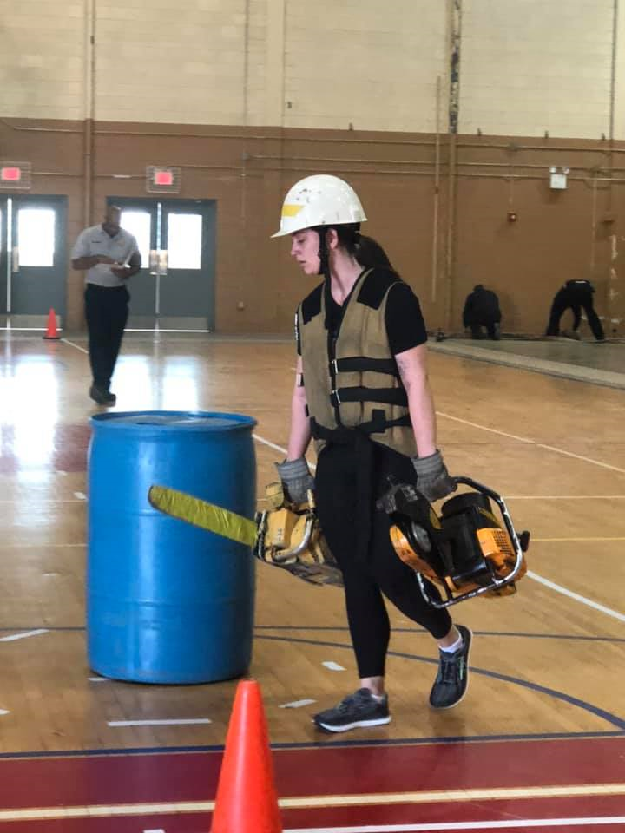
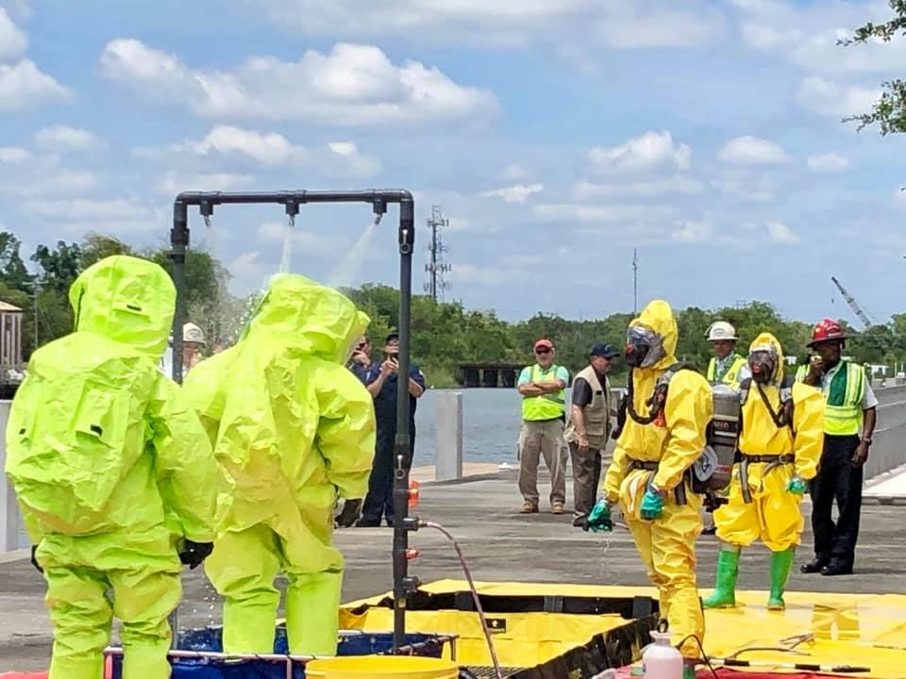
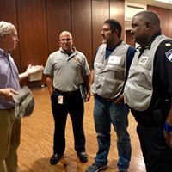
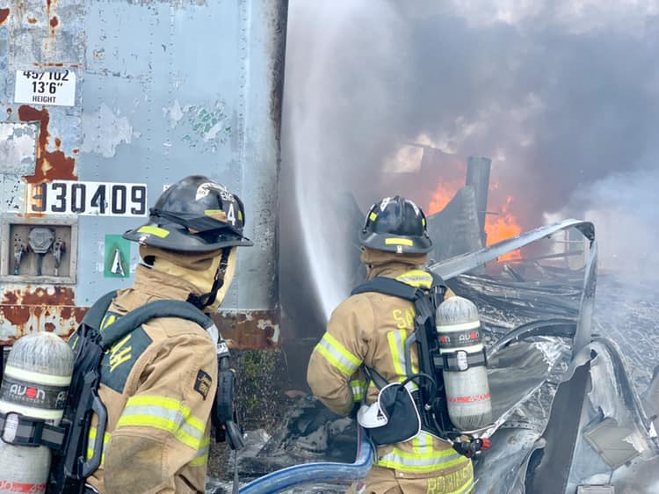
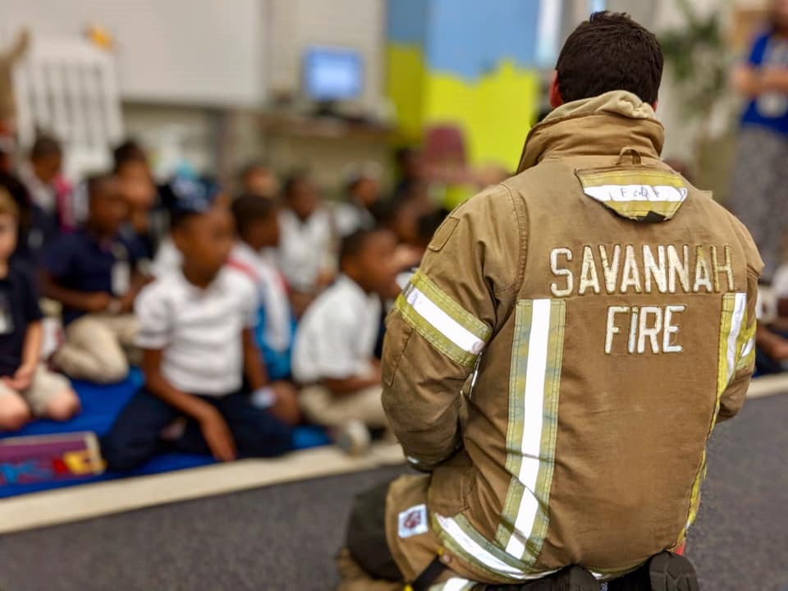
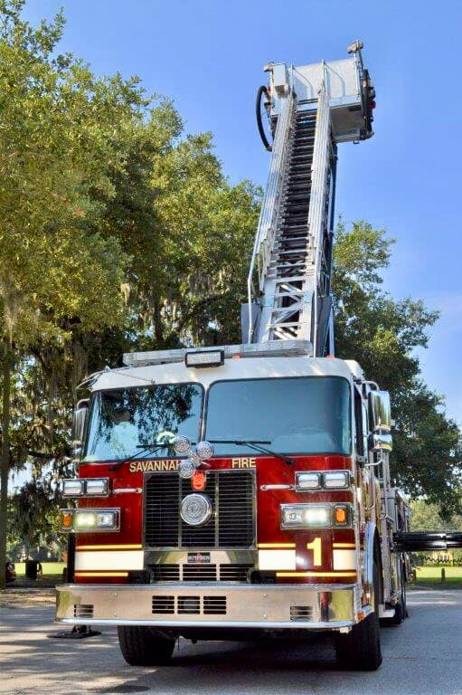
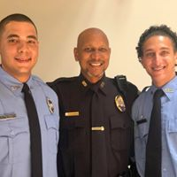
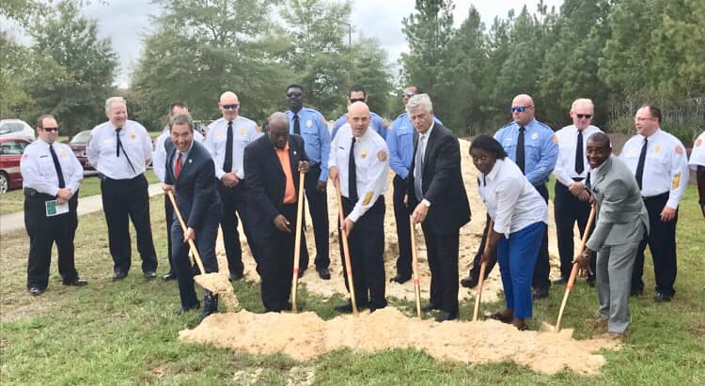
Savannah Fire Department 2019 Annual Report: Table of Contents
Table of Contents
Message from the Fire Chief Page…………………………..3
To Our Stakeholders
Organizational Overview Page………………………………..4
Vision Statement Page………………………………..5
Mission Statement Page………………………………..5
Cultural Statement Page………………………………..5
Organizational Principles Page………………………………..5
Looking Ahead Page………………………………..6
2019 Customer Service Survey Results Page…………………………..7
Savannah Fire Department Awards Page Page…………………………..8
Operations Division Page…………………………..9
2019 Fire Analysis Page………………………………..10
Special Operations Page………………………………..11
District Analysis Page………………………………..12
Logistics Department Page…………………………..13
Fleet Division Page………………………………..14
Training Division Page……………………………..…14
Community Risk Reduction Page……………………………..…15
Inspections Page……………………………..…15
Community Outreach Page……………………………..…15
Investigations Page………………………………..15
Emergency Management Page……………………………16
Appendices Page……………………………17

Slide 3
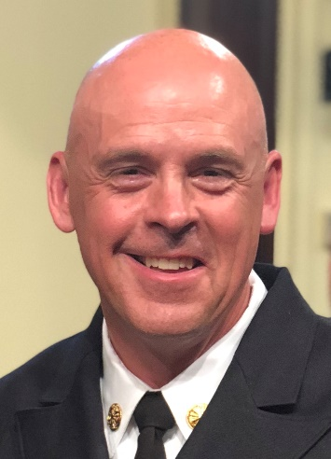


Savannah Fire Department 2019 Annual Report: Fire Chief Message
It was a prestigious honor for me to be named Chief of the Savannah Fire Department in June of 2019. We have experienced a great deal together in those nine short months: major fires and technical responses, a Strategic Plan and citywide Risk Assessment process and a variety of tragic and adverse situations that touched each of us personally. I am proud to be part of a special family that is selflessly dedicated to serving those in need. We are a team and each man and woman of the Savannah Fire Department fills an important role. Teams are successful when every individual can focus on the greater good and do their part efficiently and effectively. Savannah Fire does this better than anyone. It is a testament to your professionalism, devoted spirit, heart, and desire to be the best.
I am proud that you call me chief and I look forward to working with each of you to fulfill our mission and tackle future challenges
Derik Minard, MPP EFO
Fire Chief
Savannah Fire Department

Slide 4




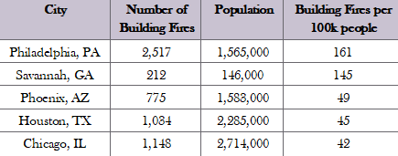





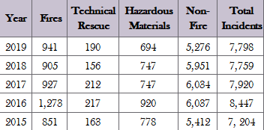

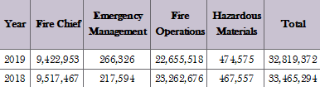
Savannah Fire Department 2019 Annual Report: Overview
SFD Resources
Building Fire Statistics
Stations Operations Admin Engines Rescues Trucks Marine
15 318 18 15 15 2 5 2
Five Year Incident Data
The Savannah Fire Department (SFD) is a professional career Fire Department comprised of 318 uniformed firefighters and 18 administrative/support staff. SFD serves a population of 145,674 people, with a service area of 108 square miles. The service area we serve includes an Industrial component along the river basin and large tracks of commercial and residential structures throughout the city limits. To protect our vibrant and diverse community, SFD provides a wide spectrum of services to include: Fire Suppression, Hazardous Materials and Technical Rescue. All of these response services are delivered from 15 Fire Stations. Within these 15 strategical placed stations are 15 Engines, 5 Ladders and 2 Heavy Rescues and an assortment of support vehicles.
This report will list the activities of the 3 major Departments within SFD: Operations, Logistics, and Emergency Management and details the work of the Divisions contained within each Department.
Our constant strive for service excellence and our culture of staying “...Committed to those we serve” will continue into 2020.
Budget Overview

Slide 5

Savannah Fire Department 2019 Annual Report: Philosophy
SFD Vision
We are committed to serving our community with the utmost levels of professionalism and efficiency in relation to the preservation of life and property.
SFD Mission Statement
The Savannah Fire Department is committed to serving and educating our city with exceptional customer service and superior emergency response. Our services are designed to reduce community risks and mitigate hazards threatening life, property, and the environment in an atmosphere that encourages innovation, professional development, and diversity.
SFD Cultural Statement
“Committed to those we serve”
SFD Organizational Principles
Professionalism
Trust
Loyalty
Safety
Teamwork
Leadership
Diversity
Service Excellence
Accountability
Customer & Employee Satisfaction
Effective Communication

Slide 6
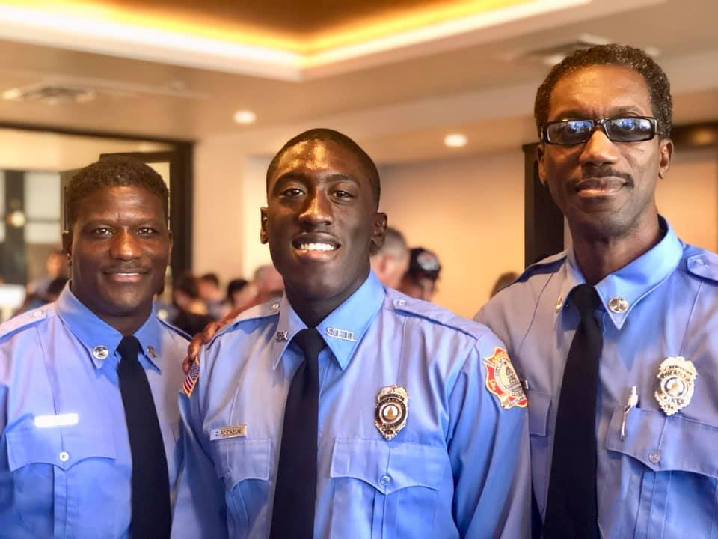
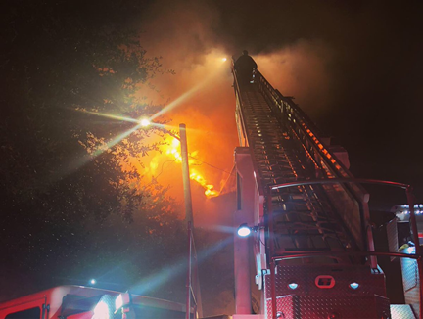
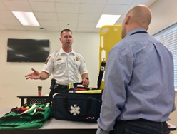
Savannah Fire Department 2019 Annual Report: Looking Ahead
Implementing the 2020-2024 Strategic Plan
Continue to meeting the goals set forth by City
Training Fire Department Personnel to the EMT Basic level
Developing and implementing EMS services by 2023
Reestablish 2017 staffing levels
Promote diversity
Enhance Cancer Reduction initiatives
Expand Community Risk Reduction programs
Foster equity
Redesign Career Development and Career Pathways

Slide 7
Savannah Fire Department 2019 Annual Report: Customer Service Survey

Slide 8
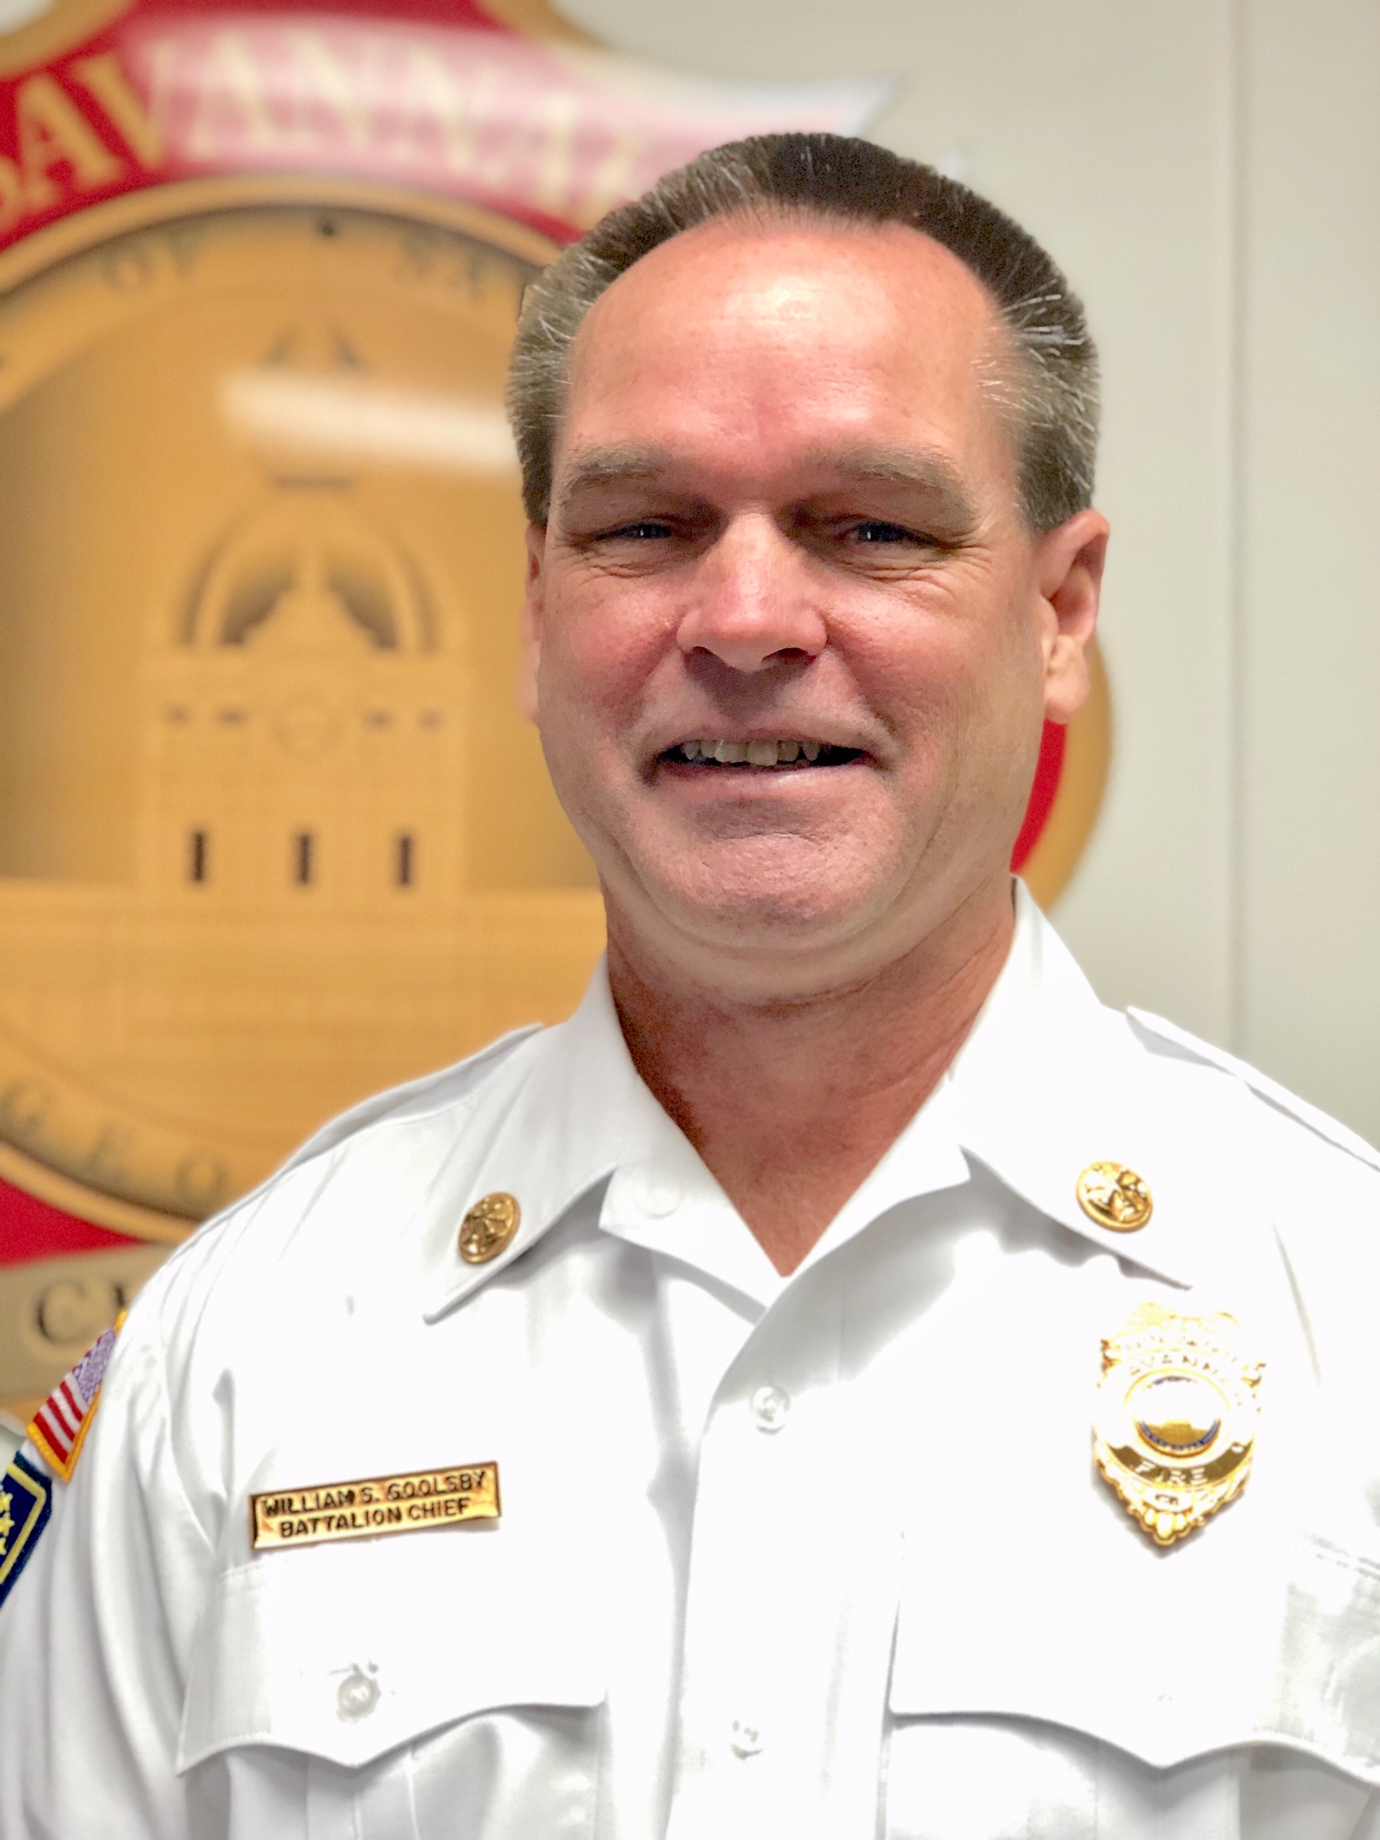
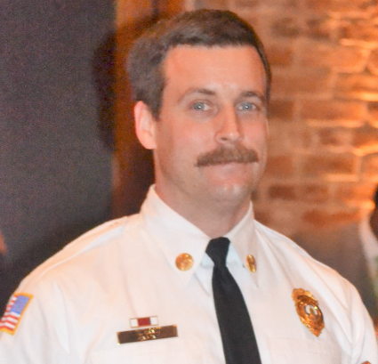
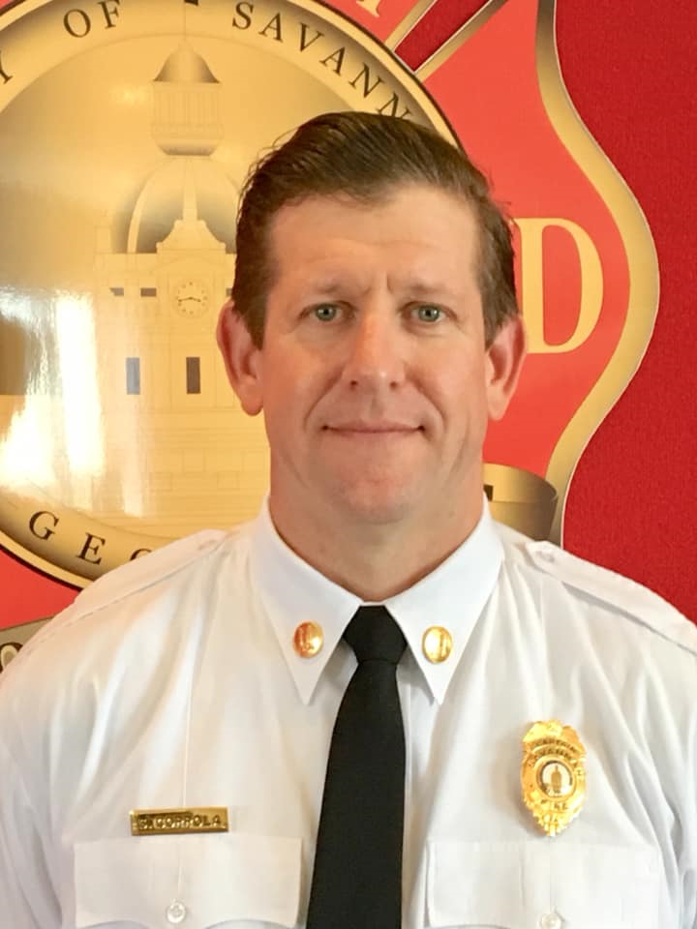
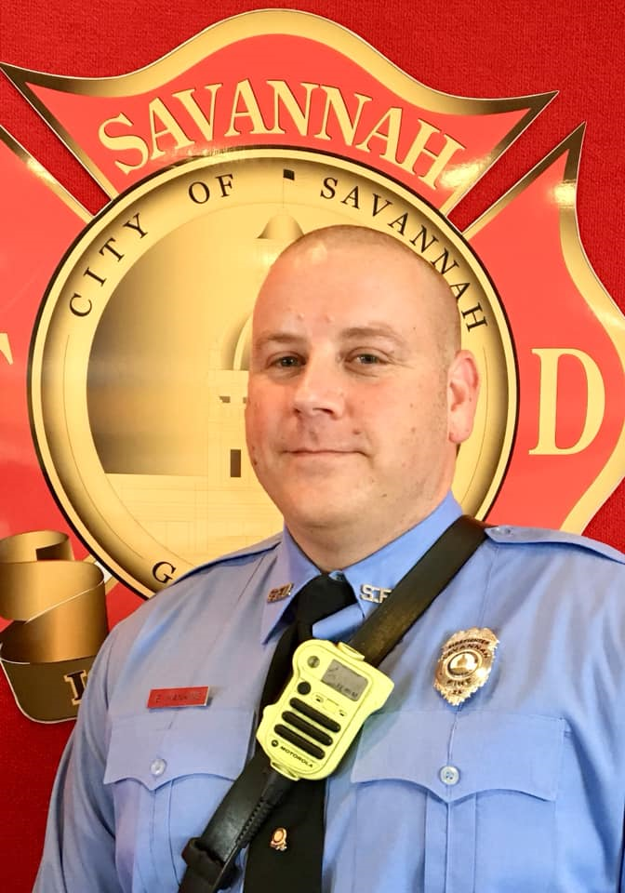
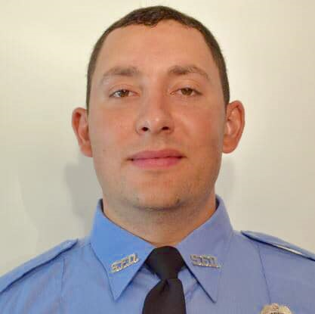
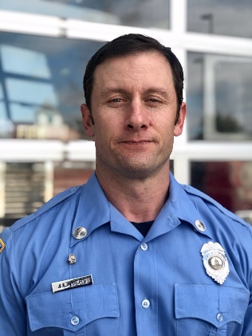
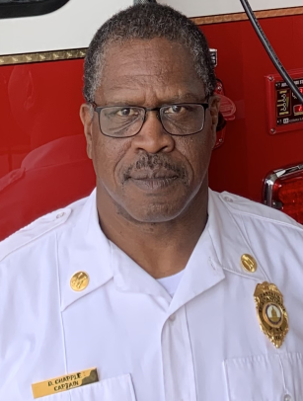
Savannah Fire Department 2019 Annual Report: Annual Awards
Chief Officer of the Year
William Goolsby
Valor Award
Justin Crain
Fire Officer of the Year
Sam Coppola
Firefighter of the Year
Benjamin Hankins
Rookie Firefighter of the Year
Hector Melecio
Fittest Firefighter
Joel Hiers
Fittest Senior Firefighter
Dietrich Chapple

Slide 9
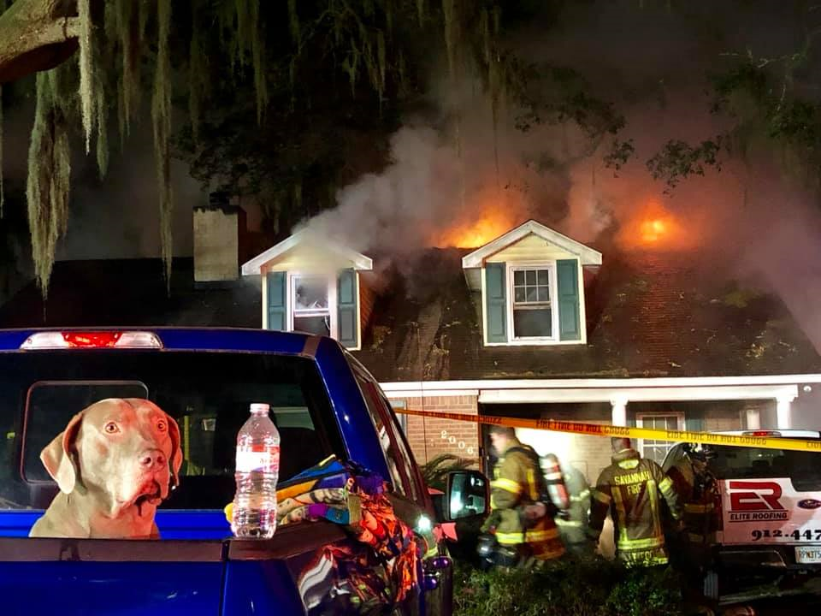
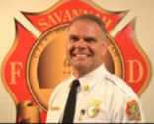
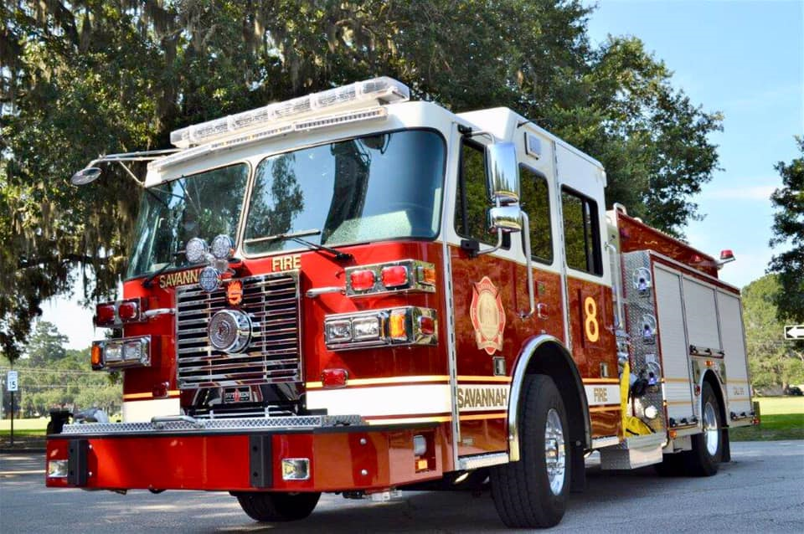
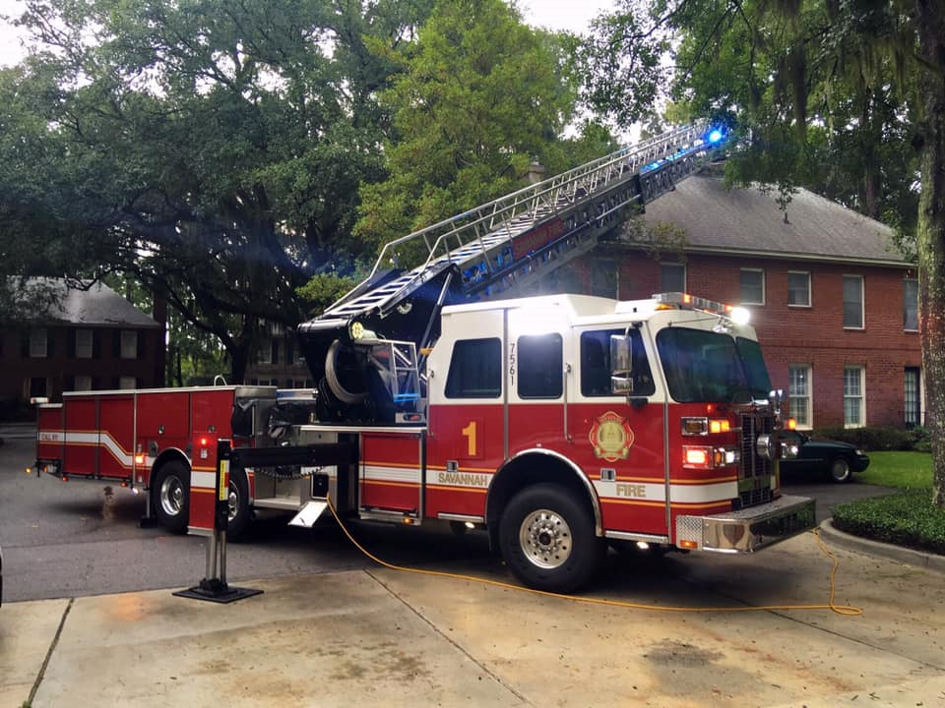
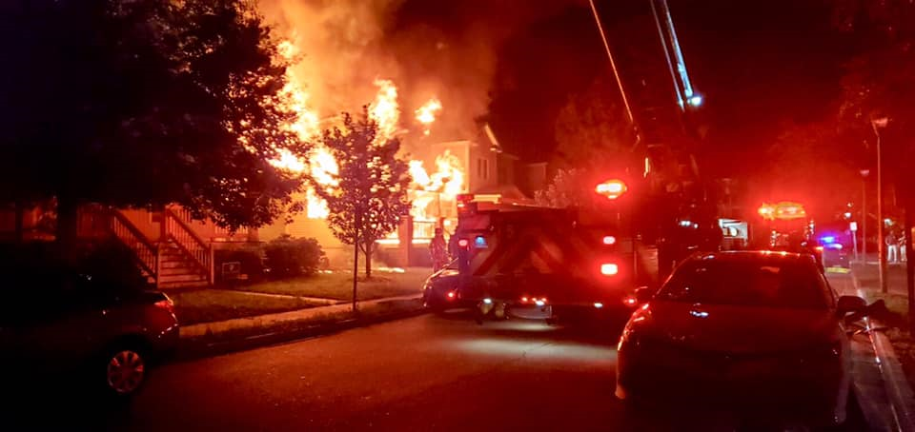
Savannah Fire Department 2019 Annual Report: Operations
William Handy
Assistant Chief Operations
The goal of Savannah Fire Department Operations Division is to support Community Risk Reduction initiatives. To support these initiatives, the Operations Division utilizes 15 Fire Stations, 23 Companies and 318 uniformed personnel that are strategically placed throughout the city in relation to the city’s risk assessment. By constantly monitoring our response efforts through data collection, the Operations Division is able to effectively and efficiently respond to a wide spectrum of natural and manmade incidents. The results of our efforts have led SFD to receiving the highest Insurance Services Office (ISO) rating, ISO Class-1 and International Accreditation from the Commission on Fire Accreditation International. All this ensures that we stay true to our culture of being, “committed to those we serve”.

Slide 10
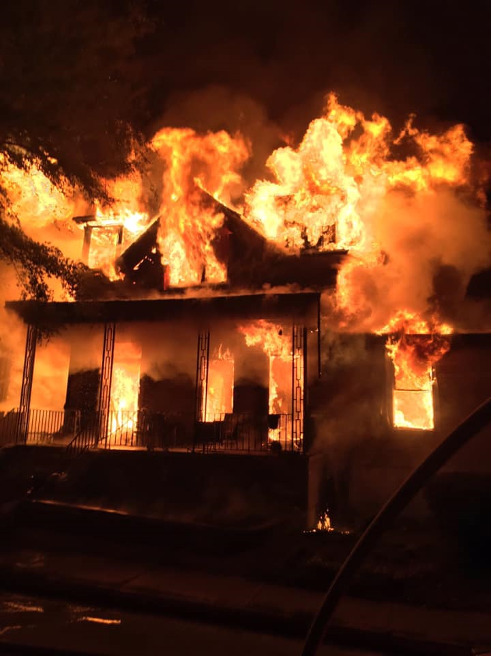
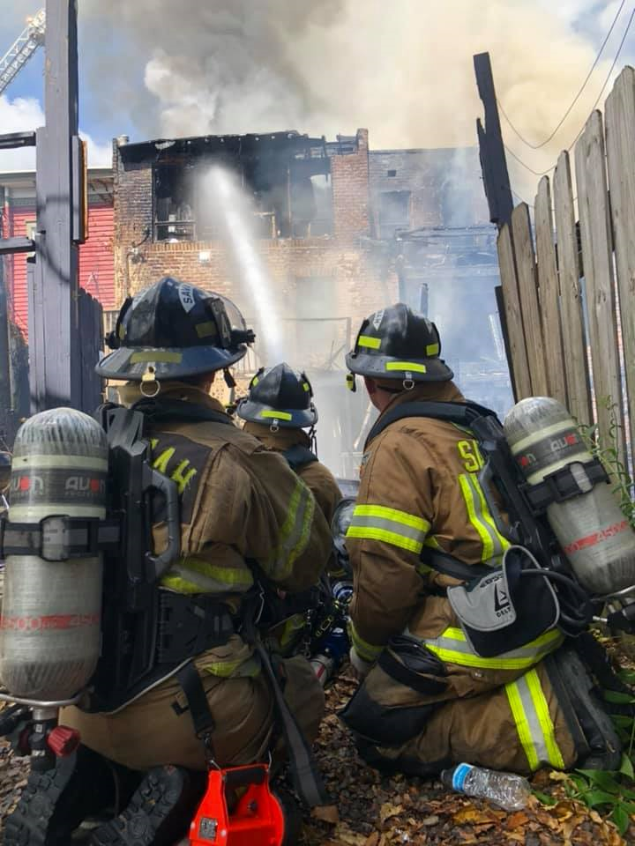
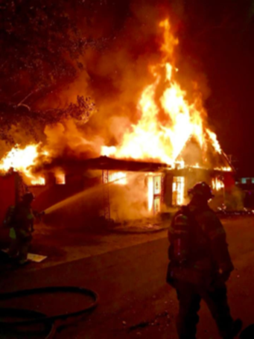
Savannah Fire Department 2019 Annual Report: Fire Analysis
Number of Building Fires in COS | Number of Building Fires Requiring Full SFD Response | Percentage
212 | 151 | 71%
Number of Building Fires Requiring NFPA 1710 Benchmarks | Number of SFD Response Meeting NFPA 1710 Benchmarks | NFPA 1710 Success Percentage by SFD
151 | 145 | 96%

Slide 11
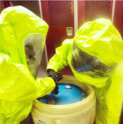
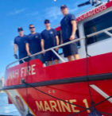
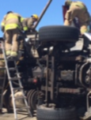
Savannah Fire Department 2019 Annual Report: Special Operations

Slide 12
Savannah Fire Department 2019 Annual Report: Incident Analysis

Slide 13
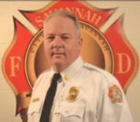
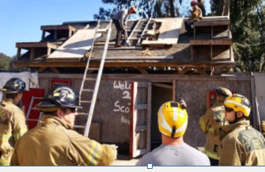
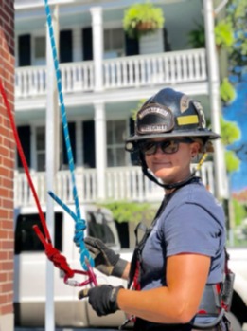
Savannah Fire Department 2019 Annual Report: Logistics
Curtis Wallace
Assistant Chief Logistics
The Logistics Division is comprised of the following: Fleet Management, Service Support, Budget & Purchasing, Human Resources Administration, Fire Prevention Office, and Training.
The Training Division is responsible for providing educational training to all service areas within the organization.
The Fleet Division works with the City’s Vehicle Maintenance shop for preventative maintenance and repairs to our equipment and vehicles.
The Fire Prevention Office includes the Arson and Inspections offices who enforce fire code compliance, conducts plan reviews and inspections.
The Logistics Division also oversees the Research and Planning Office (RPO) which is responsible for maintaining compliances with the Center of Public Safety Excellence (CPSE) and the Insurance Services Office. RPO is also responsible for Data and Records Management and calculates the performance baselines and benchmarks to ensure SFD is meeting or exceeding their response commitments to the community.

Slide 14
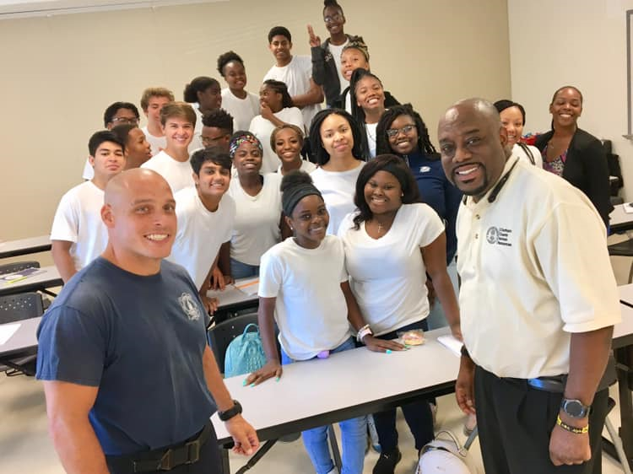
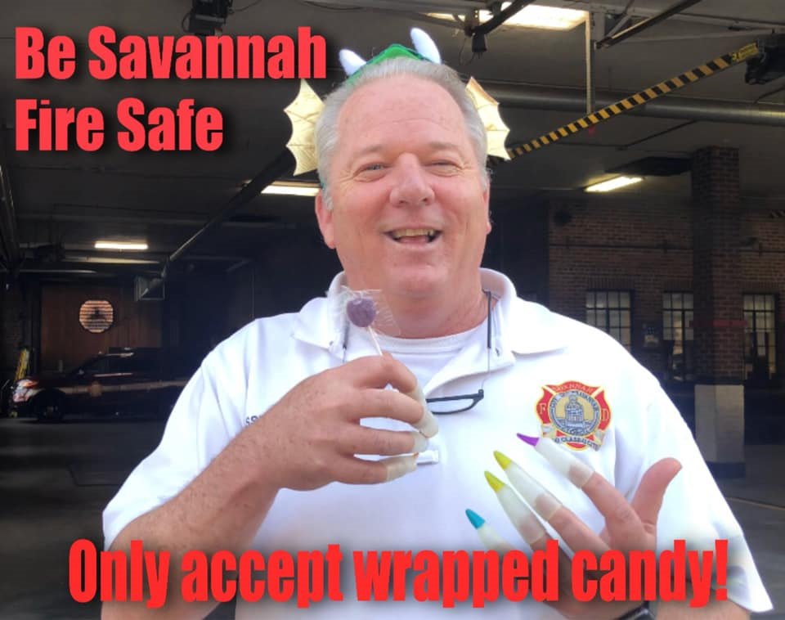
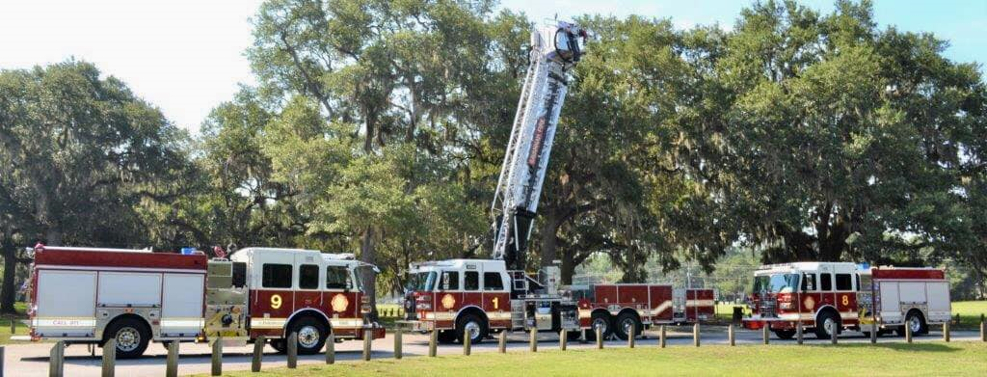
Savannah Fire Department 2019 Annual Report: Logistics
Fleet
Apparatus Pumps tested and passed according to NFPA 1901: 33 (all)
Apparatus serviced/maintained according to NFPA 1911 by shop: 30 (of 33)
Aerial Device testing (outsourced 3rd Party) according to NFPA 1914: 9 tested and passed (all)
Ground Ladders tested: (ground feet) 5200’
New Apparatus received in 2019: 3 (2 pumpers and 1 aerial)

Slide 15
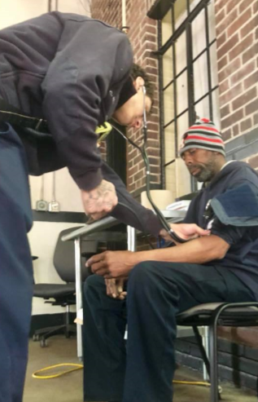
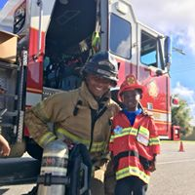
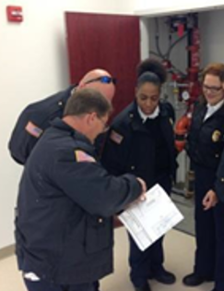
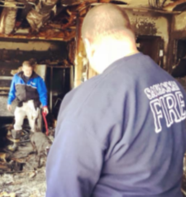
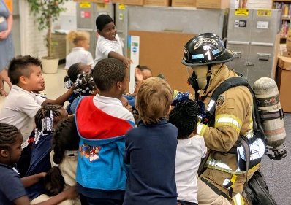
Savannah Fire Department 2019 Annual Report: Community Risk Reduction
Arson Arrest | 6
Arson Convictions* | 2
Fire Fatalities | 5
* Cases have not gone to trial
Community Risk Reduction Contacts
in 2019: 20,096

Slide 16

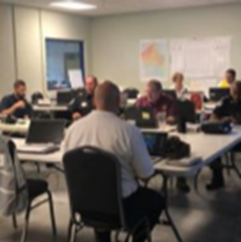
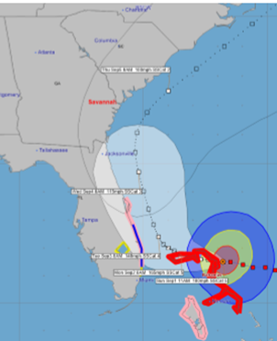
Savannah Fire Department 2019 Annual Report: Emergency Management
David Donnelly
Emergency Manager
Savannah Fire Preparedness is a division of the Fire Department. The mission of Savannah Emergency Preparedness is to expedite the return to a safe, healthy and thriving community through effective implementation of best practices and innovative approaches. This is accomplished through planning, training and exercises that prepare City staff to respond to and recover from disasters, as well as to mitigate and prevent hazards and threats. The Emergency Preparedness Team meets regularly to develop emergency plans and procedures. The City’s Incident Management Team carries out the plans in order to maintain public safety, restore infrastructure, and assist in economic and community recovery and to ensure good government by tracking and recouping costs. City of Savannah personnel honed their incident management skills by responding to Hurricane Dorian, managing the City’s involvement in the 194th St. Patrick’s Day parade and festival as well as the Rock N’ Roll marathon. Emergency Preparedness works with partners, such as Georgia Ports Authority, the Coast Guard, U.S. Army Corps of Engineers and Chatham County in planning and participating in disaster exercises.

Slide 17
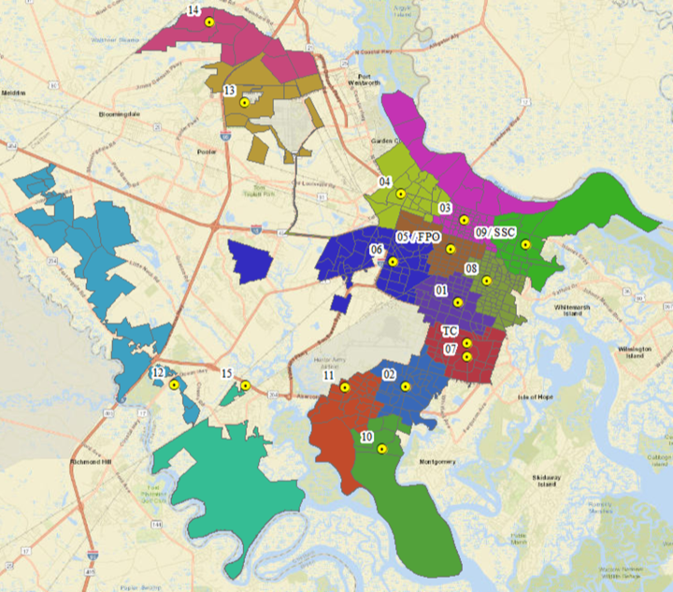
Savannah Fire Department 2019 Annual Report: Appendix 1
Station Locations

Slide 18
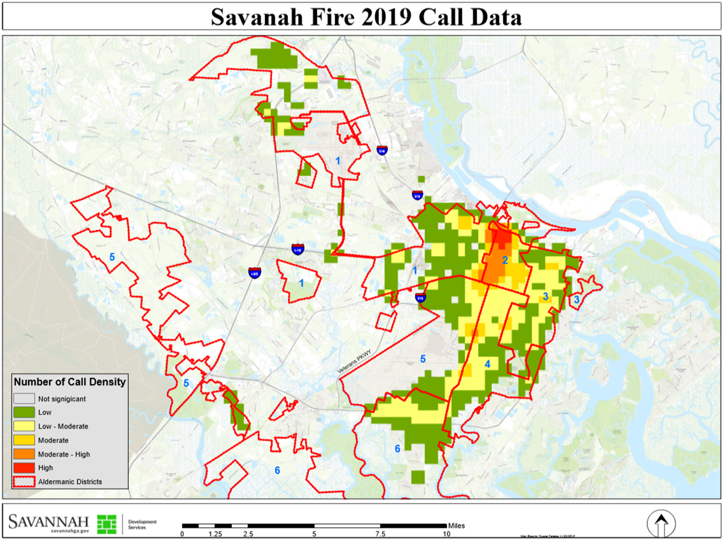
Savannah Fire Department 2019 Annual Report: Appendix 2
2019
Incident Heat Map

