Slide 1
The Cluskey Embankment stores investigation project
By: The Earl T. Shinhoster Youth Leadership Institute

Slide 2
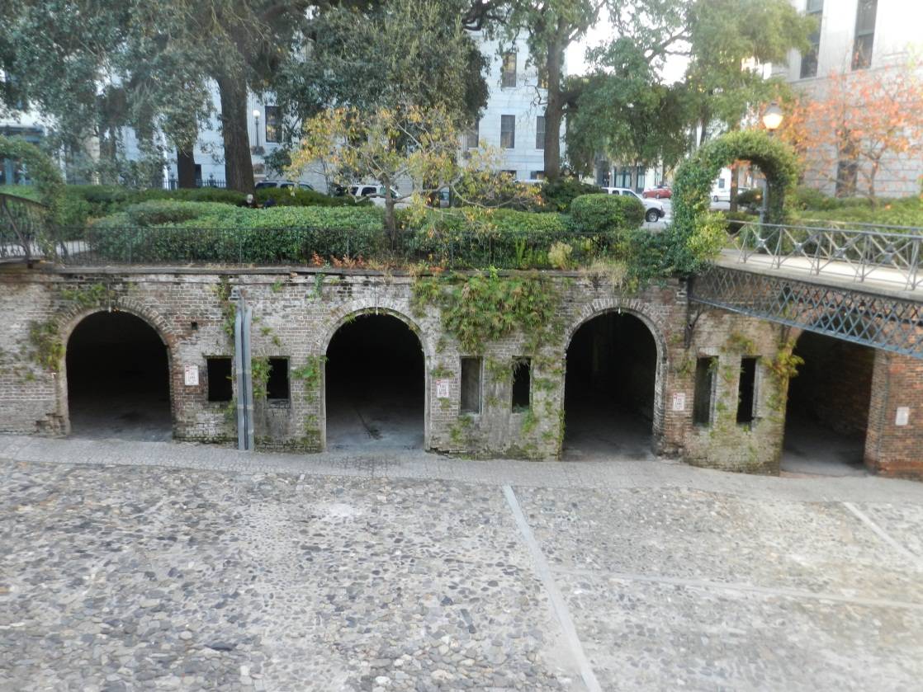
This picture of the Cluskey embankment stores includes rebuilt store and the three original.

Slide 3
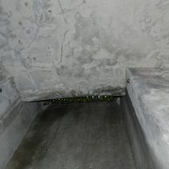
This picture was taken inside one of the stores. It appears to be an air vent possibly needed to breathe through during its time of use.

Slide 4
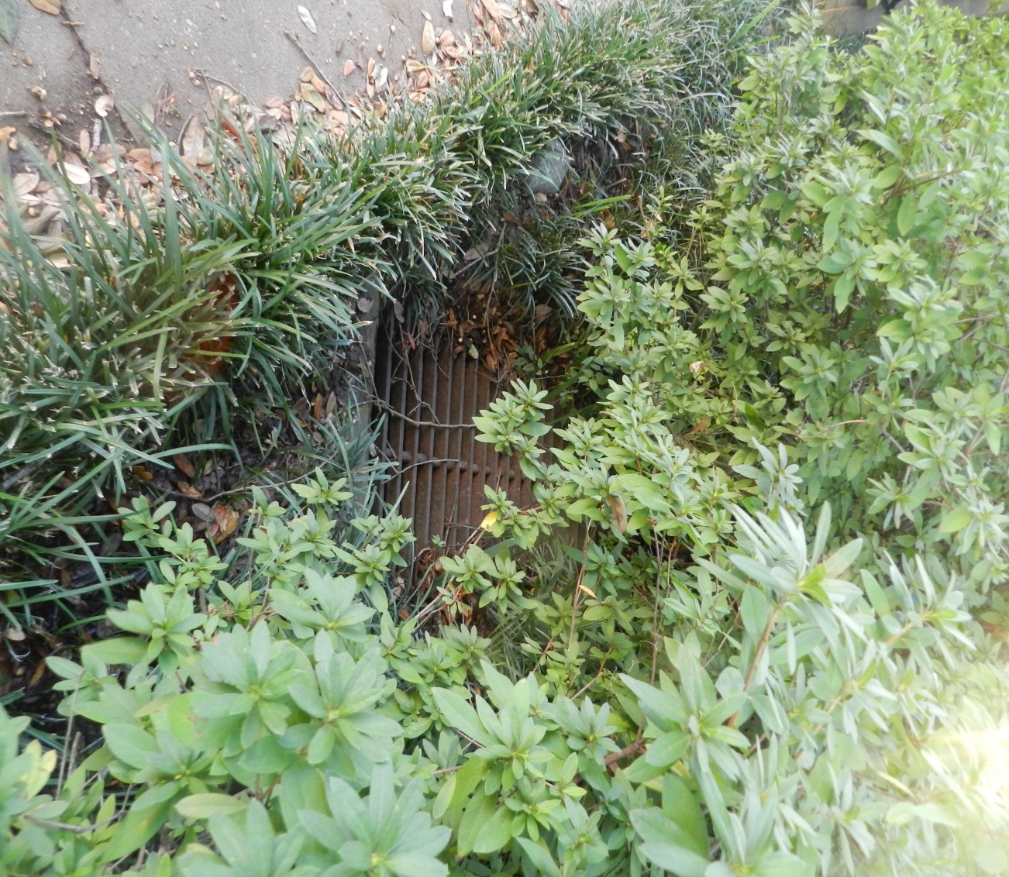
This is a picture of the outside of one of the stores. The bars in the grass are the interior air vents from the outside.

Slide 5
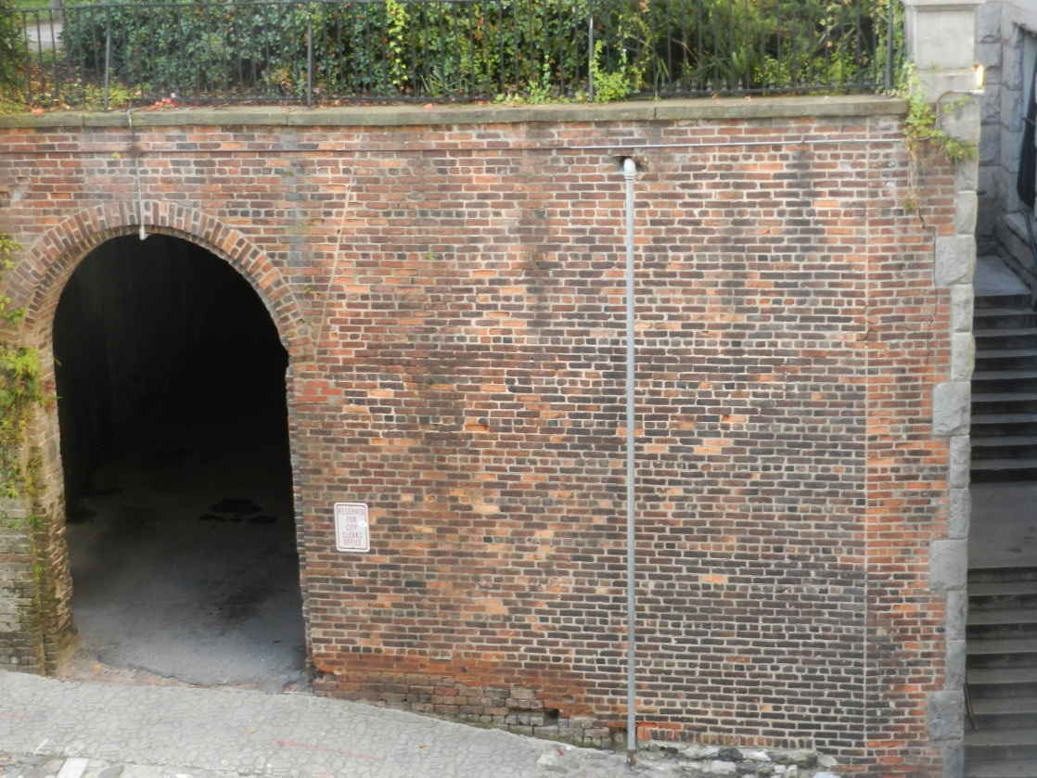
This picture is the rebuilt embankment store next to City Hall. It was rebuilt after the original collapsed as City Hall was being built in 1904.

Slide 6
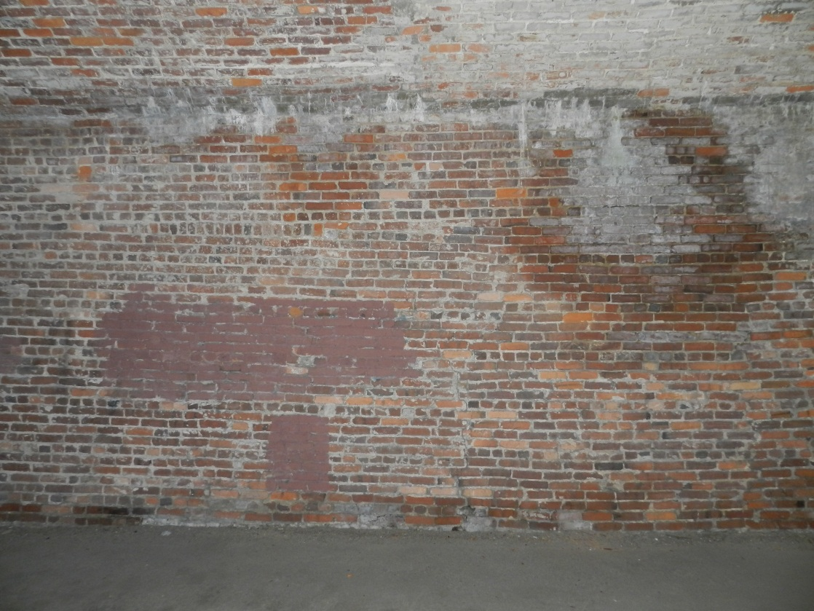
This is an interior wall made up of modern day bricks.

Slide 7
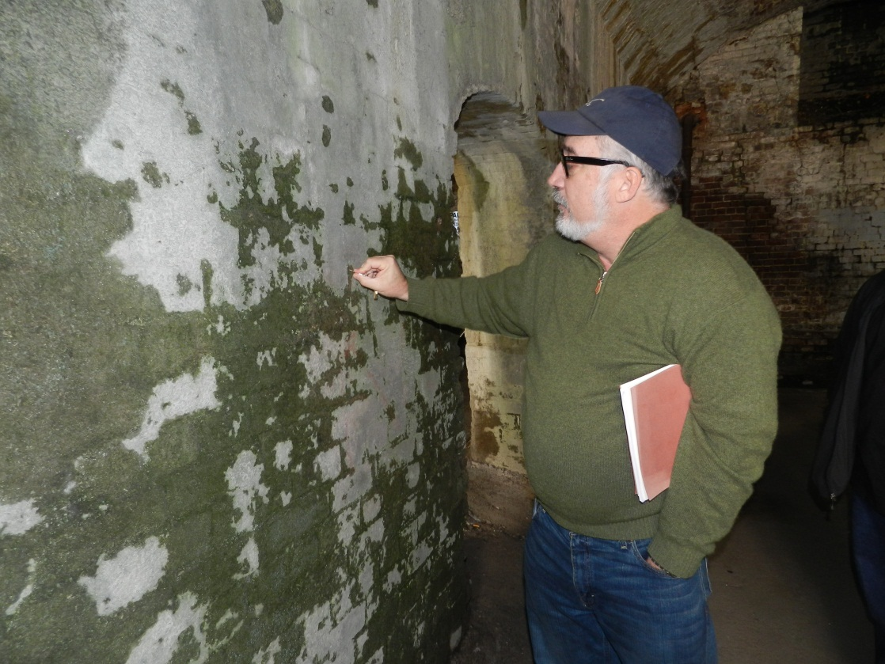
Architect Patrick Shay looks at interior wall to see if it is made of original Savannah gray bricks.

Slide 8
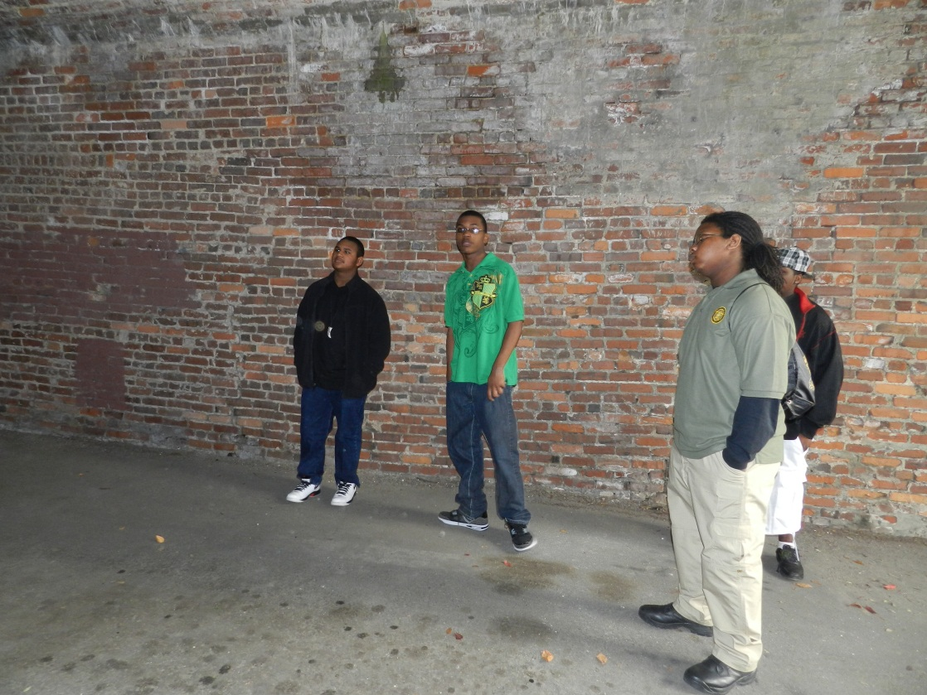
Members of Leadership Institute take closer inspection of the rebuilt Cluskey embankment store.

Slide 9
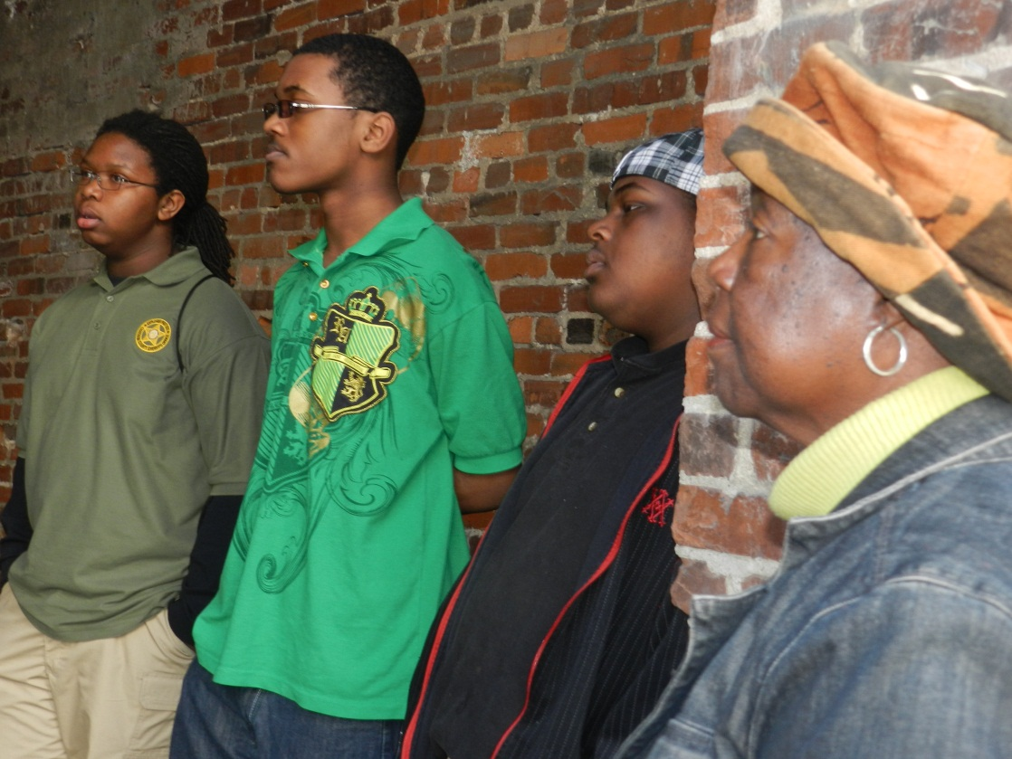
Cluskey Embankment Stores Project researchers observing the architect inspection.

Slide 10
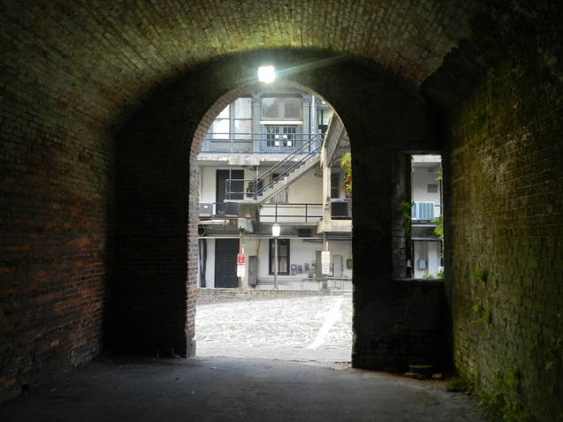
A look from inside the rebuilt embankment store.

Slide 11

One last look at the Cluskey embankment stores next to City Hall.

Slide 12
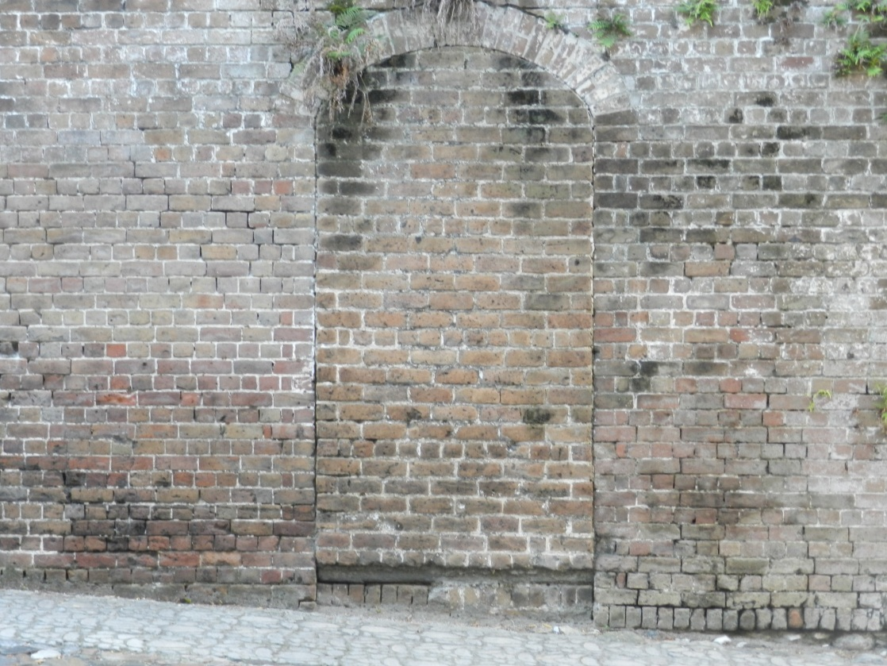
This is the fifth door:
“Opening the fifth door would be like opening a door to the past.’’
by Bobby Battle

Slide 13
Recommendations
Discontinue parking to preserve the integrity of the buildings.
Historical Markers to honor the “negro” workers injured when the structures collapsed.
Install iron see-through doors and lock for protection.
Open 5th door to see what needs to be seen and to unlock new discoveries.
Organize an archeological dig.
Continue to do research to find out if enslaved people were held there.
Place Historical markers at other sites around the city that commemorate Black History

