Slide 1



presented by
Stacey Truesdale
Senior Grants Analyst
Human Services Department
Pennsylvania Avenue Resource Center
July 2023
Notes:
Hello, my name is Stacey, Senior Grants Analyst with the City of Savannah.
I am so excited that you decided to watch this presentation and hope that you can gain important information from it.
The purpose of this PowerPoint is to provide some basic guidance that can assist organization and nonprofits with preparing budgets.

Slide 2
Overview for SUCCESS
PART 1
Commonly used budget types
Elements of a budget
Results from failing to budget
PART 2
Example budget
Program budget template from funder example
Balancing your budget
What is a budget
Agency budget template from funder example
Preparing a budget, things to consider
Notes:
If you are planning to write a grant proposal or request financial support, keep in mind that when funders are reviewing your proposals, they tend to review your budget first.
In this presentation we will discuss the following items outlined here, starting with, What is a budget?

Slide 3

What is a BUDGET?
A budget is a financial document that plans how to use expected revenue and cover cost.
Helps with setting and achieving organizational goals if done correctly.
Centered around goals and objectives.
Explains activities you are looking to accomplish.
Notes:
A budget is a financial document which lays out how your organization is planning on spending its money. This consist of the revenue you expect to receive and the costs your organization will incur on an annual basis. Ultimately, it helps with setting and achieving organization goals if done correctly.
The primary focus of your budget should be centered around the goals and objectives of the organization. So, be specific, explain activities that you are looking to accomplish in the given year as most funders will require applicants to explains how they will fund and sustain their organizational goals.

Slide 4
What is a BUDGET?
GOALS
What do we want to achieve?
PROGRAM & ACTIVITIES
What programs will help you achieve your goals?
SUPPORT
Where will your resources come from?
FUNDING
What tools, services, supplies will you need?
Notes:
When planning, below are some questions to consider:
These questions are vital because it helps guide you through the planning process.
You may want to consider…
What do we want to achieve?
What programs or activities will help you achieve your goals?
Where will your resources come from?
What tools, services, and supplies will you need?
Keep the following questions in mind when you are planning for success.
Let’s continue with reviewing the common type of budgets.

Slide 5


Operating BUDGET
OPERATING BUDGET
(AGENCY BUDGET)
REVENUE
EXPENSE
PROGRAM #1 BUDGET
REVENUE
EXPENSE
MEMBERSHIP DUES
FUNDRAISING
SALARIES BENEFITS
PROGRAM SUPPLIES
TRANSPORTATION
IN-KIND DONATION
GRANTS
FUNDRAISING
RENT
UTILITIES
PROFESSIONAL SERVICES
TIP: BE CAUTIOUS
Do not anticipate that grant income will be the sole support.
Consider budget line items most subject to inflation (e.g., food, transportation).
Think about timing, when income will be received, and expenses will be paid.
Notes:
While there are several types of budgets, one of the most common is an Operating Budget. It includes all aspects of running the organization and is used to plan finances for daily activities and recurring expenses like (grants and/or fundraising, administrative overhead, etc.)
Depending on your organizational structure you may require a separate budget for (projects, programs or events) also known as the Program Budget which will roll into the Operating budget.
Below are some tips to keep in mind:
Do not anticipate that your grant income will be the sole support. This is important because should this funding scream become unavailable you won’t have other means for sustaining your organization.
Also, consider budget line items most subject to inflation (e.g., food, transportation) when planning for expenses.
Finally, think about timing, when income will be received, and expenses will be paid. This is important because some funders may be performance driven and may not disburse funds upfront to cover expenses.
The overall objective is to always make sure you have multiple funding sources and that you are planning organization goals.
Let’s continue with reviewing the elements of a budget.

Slide 6
Elements of a BUDGET
TWO main elements of a budget
Revenue: Refers to income that contributes to the operations of an organization.
Expenses also known as Expenditures: Refers to cost that contributes to an organization’s overall cost of doing business.
REVENUE
(specific to grant focused budgets)
Grants (Federal, State, Local, etc.)
EXPENSES
(specific to grant focused budgets)
Salaries, Taxes and Benefits
Donations
Fundraising Events
Contribution
Rent
Program Supplies
General Operating Cost
Professional Services (legal, CPA, consultants, etc.)
In-Kind Donations (a non-cash gift, volunteers)
Utilities
Membership Fees
Notes:
So, there’s TWO main elements of a budget:
Revenue: Refers to income that contributes to the operations of an organization.
Expenses also known as Expenditures: Refers to cost that contributes to an organization’s overall cost of doing business.
In the illustration below, some common revenue and expense types that are specific to grant focused budgets is listed here.
Just keep in mind that each category mentioned below may or may not be included in your budget and depending on the size and structure of your organization may include additional categories.

Slide 7
Balancing your BUDGET
A balanced budget = revenues equal to or greater than total expenses
A budget variance (difference) REQUIRES an explanation.
A positive variance = actual revenue higher than what was budgeted OR expenses lower than budgeted
A negative variance = funding falls below what was budgeted OR expenses over what was budgeted
Keep in mind a well-prepared budget should be reasonable.
TIP: BE TRANSPARENT
Should non-profit budgets be balanced, or do they need to show a net profit?
Would funders consider my organization for a grant if I show a net profit or loss?
Notes:
A balanced budget occurs when revenues are equal to or greater than total expenses. But keep in mind that any budget variances you may have will require a reason regardless if it is a positive variance or negative variance.
A positive variance is the result of revenue being higher than what was budgeted OR when your expenses is lower than what you budgeted.
And a negative variance is the result of funding falling below what was budgeted OR when expenses is over what you budgeted . So your budget should always be well pre-pared and reasonable.
Tip: You should always be transparent because there is no sure way of knowing if a funder will grant or deny an award if your budget shows a profit or a loss.
The important thing to keep in mind is that when applying for funding make sure you are clear on the grant requirements and follow them. Let’s continue by reviewing failing to budget.

Slide 8
Failing to BUDGET
Donors and grantors may choose not to fund your organization.
Could result in higher spending when there are no spending limits in place.
Creates uncertainty for management whether organizational goals can be met.
Notes:
Possible outcomes from failing to budget:
Could result in higher spending when there are no spending limits in place.
Donors and grantors may choose not to fund your organization.
Creates uncertainty for management whether organizational goals can be met
Let continue with reviewing Part 1 Recap..

Slide 9
Budgeting for SUCCESS
PART 1: RECAP
Key Takeaways…
You need money to spend money, you should not rely on one funding source to operate.
Failing to budget could result in possible overspending, not getting funded, or not meeting goals.
Operating budgets are the most common type of budgets used.
The two main elements of a budget are Revenue and Expenses.
Budget variances will require an explanation whether positive or negative.
A well-thought-out budget can show funders you are credible.
Notes:
A well-thought-out budget can show funders you are credible.
You need money to spend money, you should not rely on one funding source to operate.
Operating budgets are the most common type of budgets used.
The two main elements of a budget are Revenue and Expenses.
Budget variances will require an explanation whether positive or negative.
Failing to budget could result in possible overspending, not getting funded or not meeting goals.

Slide 10
Preparing a BUDGET
Consider the organization goals and funder’s requirements.
Determine operating/program cost, and make sure the grant budget aligns with your purpose and goals.
Funders usually require established nonprofits to provide prior year actuals, current year projected, and next year proposed.
Funders usually require new organizations to demonstrate their proposal is sustainable and shows other funding sources.
TIPS: BE PREPARED
Actuals
Final recorded revenues and expenditures at the end of a budgeted period.
Projected
Forecasted revenues and expenditures, for a budgeted period.
Proposed
Estimated program expenditures requested to complete a project.
Notes:
When budgeting for a grant it is important that you consider the organization goals and funder’s requirements, determine operating/program cost, and make sure that your grant budget aligns with your purpose and goals.
For established nonprofit, funders usually want prior year actuals, your projected budget, and the proposed budget.
But for new organizations seeking funding, funders would like to see you demonstrate how your program or project aligns with there needs and if it can be sustained.
It is important that you are prepared and understand the differences between an actual, projected and proposed budget.
Actuals are your completed prior year budget that shows how you preformed in that year.
Your Projected is a forecast or estimate for what you expect to do in the current year.
And your proposed is a forecast or estimate for what you expect to do in the next year.
So, what does a funder really want:
Information pertaining only to the grant you’re applying for,
Information about the program or project you’re looking to get funded, OR
Your overall operating budget

Slide 11
Preparing a BUDGET Continued
What specific budget information do you need to provide in the grant proposal?
What type of expenses are eligible and what time period does the grant cover?
What level of detail is the funder looking for?
Grants are usually annual but may be extended or for longer terms.
Plan for spending the money you requesting.
Program cost for the program or project you’re looking to get funded.
Most grantors want line-item budgets (e.g., salaries, benefits, professional services, rent, transportation, etc.).
Eligible expenses will likely be expenses related to the grant program only.
Sources of income (you should demonstrate that you have multiple streams of revenue).
Your overall operating budget should also detail the program budget.
Notes:
Specific information you should consider including in your grant proposal are:
Sources of income
Program cost
And plans for how you intend on spending the funding you are requesting
Eligible expenses will likely be expenses related to the grant program only.
Please note that grants are usually annual but may be extended or for longer terms
Ultimately, Your overall operating budget should be detailed.
Lets review an example of a budget..

Slide 12
Example- BUDGET METHODOLOGY
REVENUE
Local Grant | $25,000 | Grant applied for
United Way Grant | $56,885 | Confirmed grant
Community Foundation Grant | $30,500 | Confirmed grant
Corporate Sponsors | $10,000 | 10 sponsors @ $1,000 each
Individual Donations | $10,000 | 100 individuals @ $100 each
In-Kind Donations (a non-cash gift) | $10,000 | Half of snacks/meals to be donated
TOTAL REVENUE | $142,385
EXPENSE
Rent | $10,000 | $1000/month for 10 months
Utilities | $5,000 | $500/month (average) for 10 months
Tutors | $90,000 | 10 tutors @ $15/hour, 15hours/week for 10 months
Payroll Taxes | $6,885 | 7.65% Employer FICA taxes
Computer Technology | $7,500 | 10 new computers @ (750 each)
Educational Supplies | $3,000 | $300/month (avg) for paper, books, games, art, etc.
Snacks/Meals | $20,000 | $2/day for 50 students, 5 days/week for 10 months
TOTAL EXPENSE | $ 142,385
Notes:
In this example I will explain the method of budgeting. When budgeting you want to first consider how you will fund your organization.
Here the organization is requesting 25k in local grants, 56k and 30k in confirmed other grants, 10k in corporate sponsorship and individual donations which was determined by calculating the total number of sponsors and donors and multiplying it by the price each sponsor or donor will pay, and an estimated cost of non-cash gifts for 10k.
For a total budgeted revenue of $142,385
Next, the expenses the organization is expecting to pay is 10k in rent @ 1000 for 10 months, 5k in utilities @ 500 for 10 months, 90k for 10 tutors @ $15 an hour for 15hours per week for 10 months.
Payroll taxes for 6k @ 7.65% per employee
7500 for 10 new computers @ 750 each
3000 for educational supplies @ 300 per month average
And 20k for snacks and meal @ $2 per day for 50 students 5 days a week for 10 months.
For a total budgeted expense of $142,385
In this example the budget is considered balanced.

Slide 13
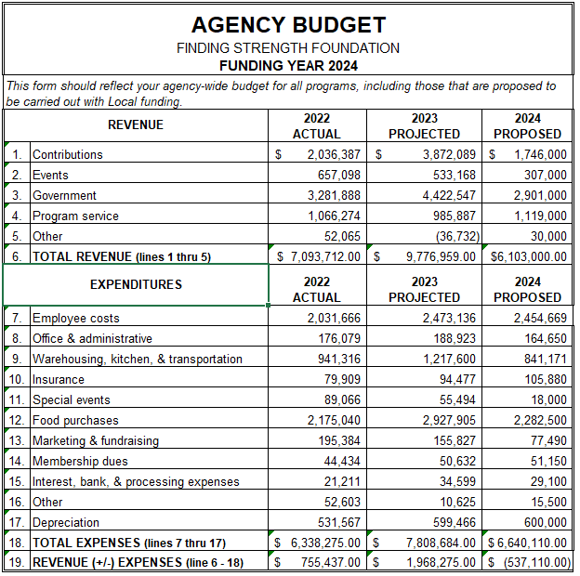
AGENCY
BUDGET
Notes:
Some grantors may provide a budget worksheet template that you have to complete. Here is an example of a template the City has provided in the past for previous grants. As some of you may know, the City also uses the software Neighborly, so sometimes grantors may ask you to complete the budget in a software program rather than filling in an Excel table.
In this example an agency is requesting funding for 2024 and has provided the breakdown of revenue and expenses broken out by 2022 actual, 2023 projected, the 2024 proposed.
Finding Your Strength Foundation had a total of 7m in revenue for 2022 that included revenue from contributions, events, grants, programs and more.
Total expenditures were 6.3m that were made up of cost like, administrative, Insurance, and marketing to name a few and this year the foundation saw a profit of 755k.
Projected for 2023 the foundation saw a profit of 1.9m due to an increase in revenue specifically, in contributions of 1.8m and government grants of 1.1m. This year the foundation also projected a small up tick in expenses, but projected funding took the lead.
Contrary to the projected budget, Finding your Strength Foundation is proposing that it will have a net loss in 2024 due to less funding and steady cost.

Slide 14
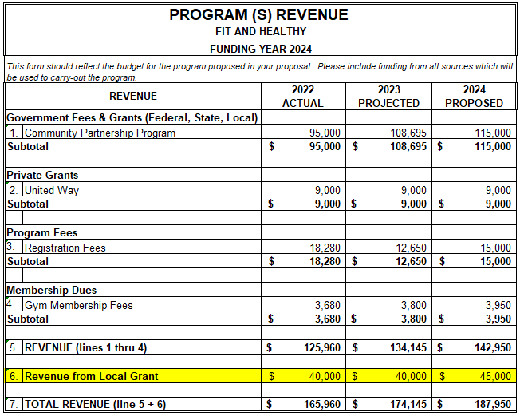
PROGRAM
BUDGET
Notes:
In this example the organization Finding Your Strength is also budgeting for their Fit and Healthy program. Here you will also see revenue broken-out by 2022 actual, 2023 projected, the 2024 proposed.
In 2022 the program received 95k in CPP funding and 9k in private grants.
In addition to grants the program also received registration fee and membership dues for a total of 125,960 in 2022 revenue.
The Fit and Healthy program also received local funding in the amount of 40k for an overall total in revenue of 165,960.
Also in this example, the program projected a total revenue in 2023 from the same funding sources of 174,145 and proposed 2024 revenues of 187,950.

Slide 15
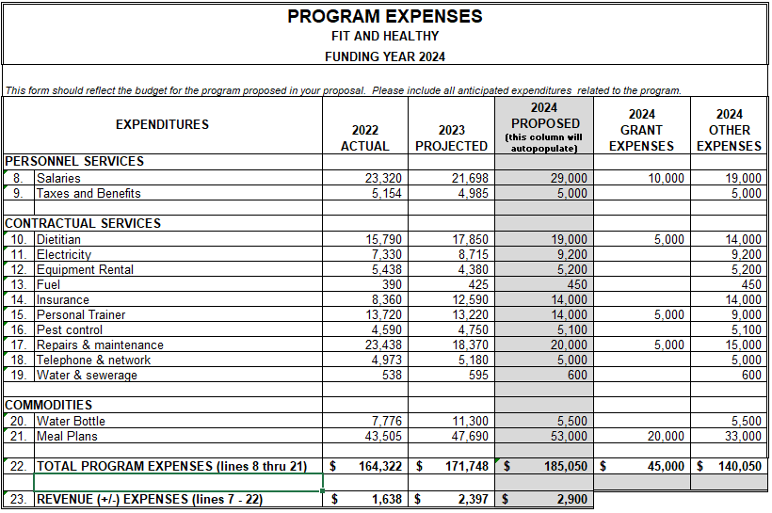
PROGRAM
BUDGET
Notes:
In this example for program expenses, the Fit and Healthy program actual expenses for 2022 totaled 164,322 and of the total some common expenses were salaries in the amount of 23,320, contractual services for personal training at 13,720 and commodities such as water bottles and meal plans that together totaled 51,281.
Here the same concept will apply to the Fit and Healthy program expense broken-out by the 2023 projected and the 2024 proposed budgeted line items just to cover a few.
Some funders also require that you split out what portion of grants and other expenses that will be used to cover proposed cost. As you can see in the example the 2024 grant will be used to cover 10k in salaries, 5k for contractual services for a dietitian and 5k for personal training, 5k for maintenance and repairs of gym equipment and 20k for food for a total of 45k in proposed expenses.
The remainder of the proposed expenses in the amount of 140,050 will be satisfied with other funding sources and the expenses are broken out by line items.
You should see that the total grant expenses and other expenses equal the total 2024 proposed budget.
The program 2022 actual, 2023 projected and 2024 proposed in this example each year has seen a small profit.
Remember, a well-thought-out budget can show funders you are credible. The Fit and Healthy program budget demonstrated that it is not relying on one funding source, it is well-prepared and reasonable, and that they have enough revenue to sustain the program.

Slide 16
Budgeting for SUCCESS
PART 2: RECAP
Key Takeaways…
Know the requirements of the funding source which you are applying.
Established agencies, be prepared to provide prior year actuals, your projected, and the proposed.
New agencies provide realistic proposals that supports your organization and/or program needs.
Have a methodology for developing budget forecasts (i.e., consider the number of participants to be served, actual cost, number of staff needed, etc.)
Be specific.
Notes:
Part 2 Recap and Key take aways
Know the requirements of the funding source which you are applying.
Have a methodology for developing budget forecasts (i.e., consider the number of participants to be served, actual cost, number of staff needed, etc.)
Be specific.
Established agencies, be prepared to provide prior year actuals, your projected, and the proposed.
New agencies provide realistic proposals that supports your organization and/or program needs.

Slide 17

Questions
Thank you Attending
Budgeting 101!
Notes:
The Human Services Department specifically runs the Community Partnership Program grant, and I have provided you additional information about the CPP grant below.

