Slide 1
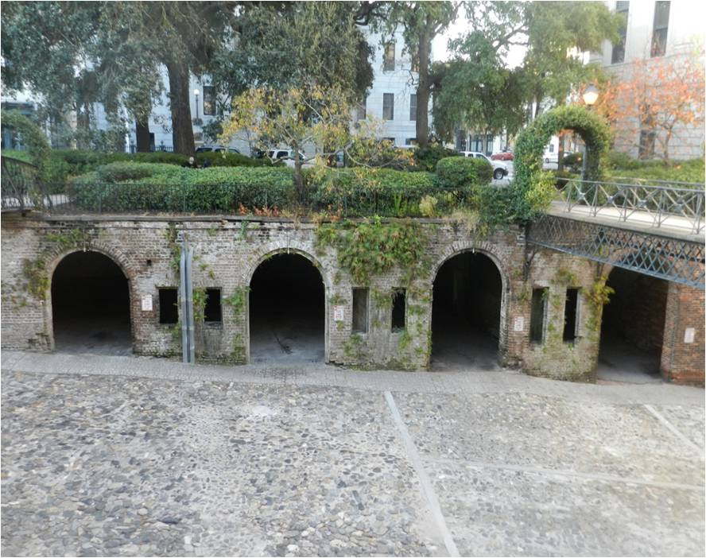
Uncovering history
The Cluskey Embankment Stores Archaeology Project

Slide 2
What Are They? What We Know!
4 open brick vaults, 1 closed vault
City contracted for retaining wall (1840)
Charles B. Cluskey, architect and contractor
Cluskey proposed incorporating brick stores/vaults
20 year lease, Cluskey transferred to John Dillon (1841)
Stores completed by William S. Walker (1842)
Total City investment: $2,957.00 plus lease

Slide 3
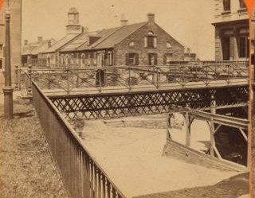
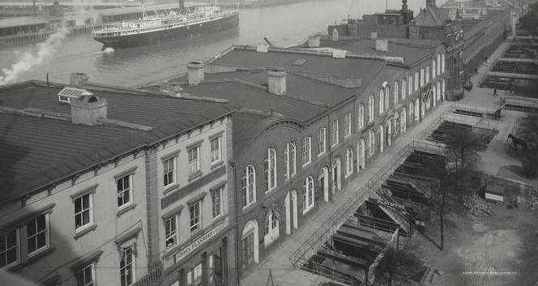
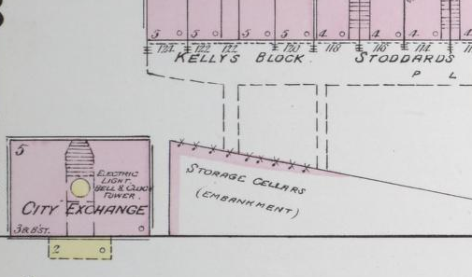
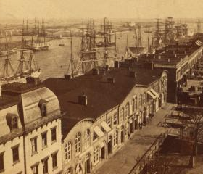
Visual Documentation
Sanborn Insurance Map, 1888; NYPL Images

Slide 4
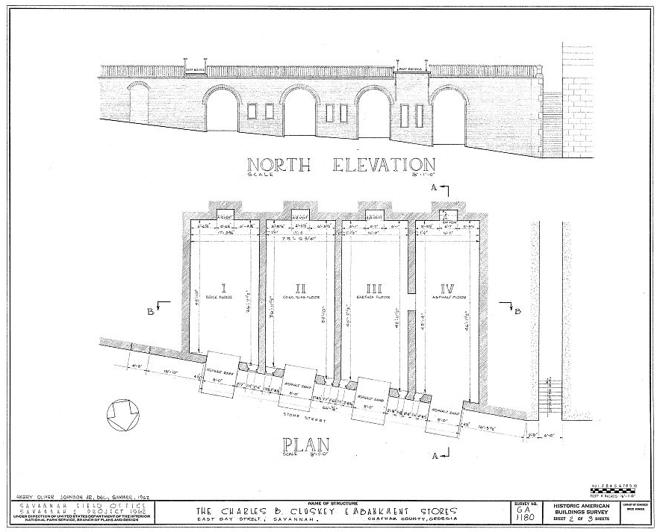
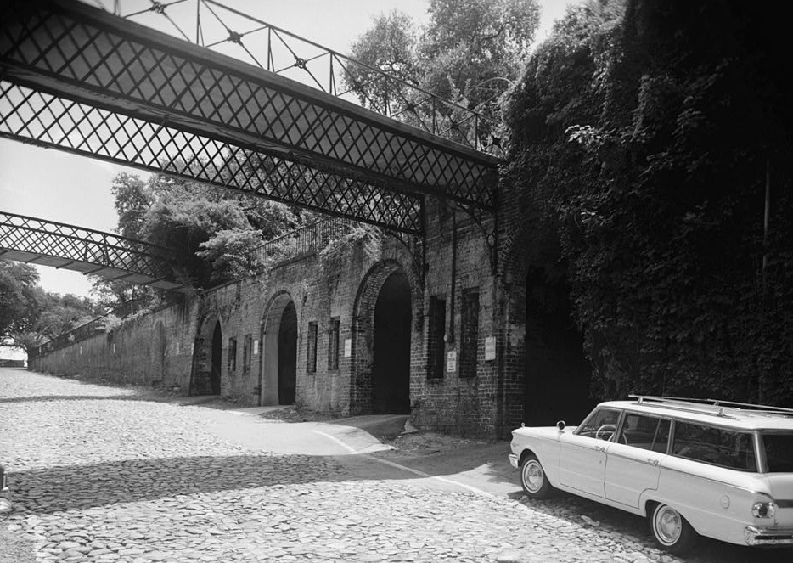
Visual Documentation
Historic American Buildings Survey (HABS), 1962

Slide 5
What We Don’t Know!

Slide 6
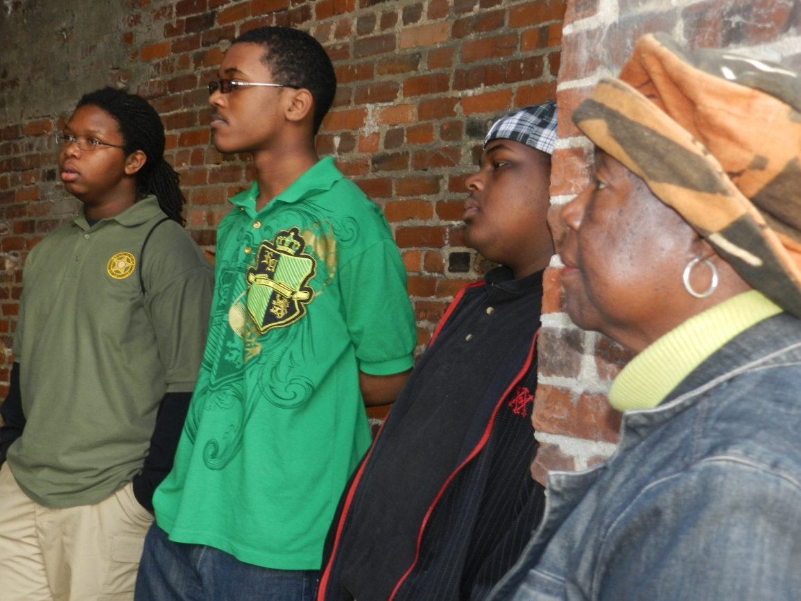
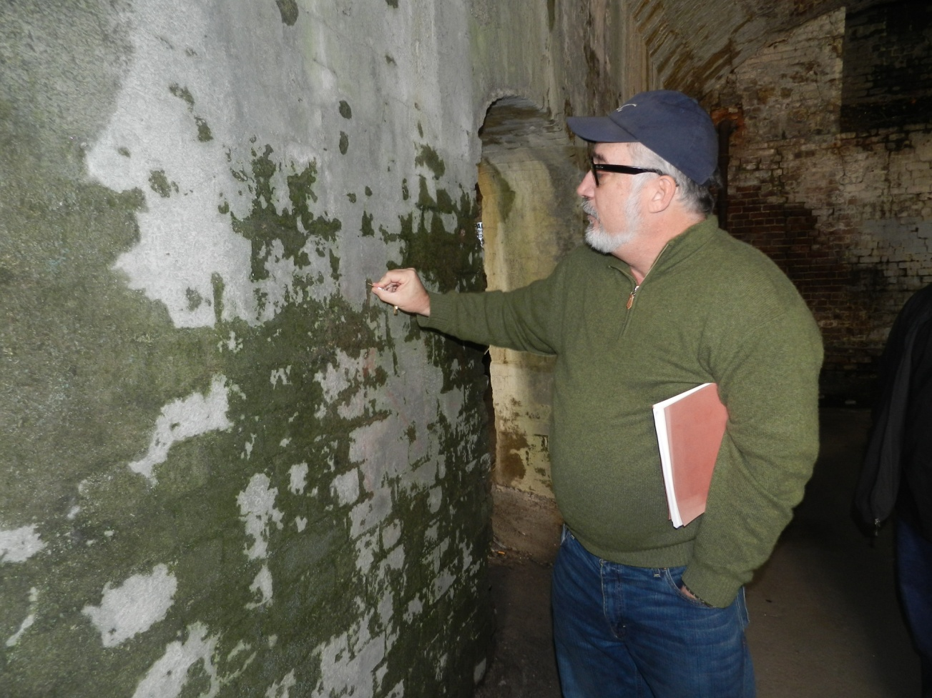
Shinhoster Youth Leadership Institute

Slide 7
Archaeological Investigation
City partnership with GSU
City contributions
GSU contributions

Slide 8
Historical Research
Ongoing
Contributors:
HABS
City Library & Archives
Shinhoster Leadership Group
GSU
SSU

Slide 9
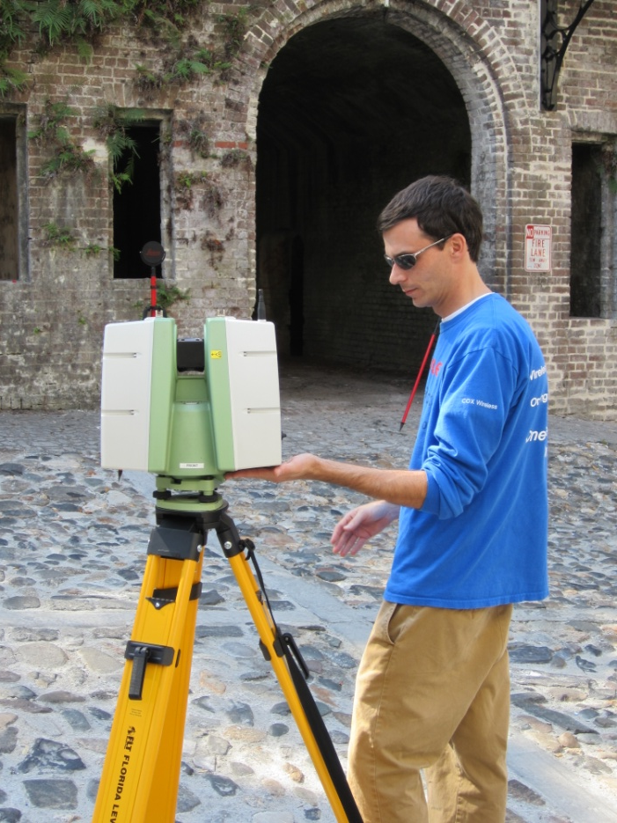
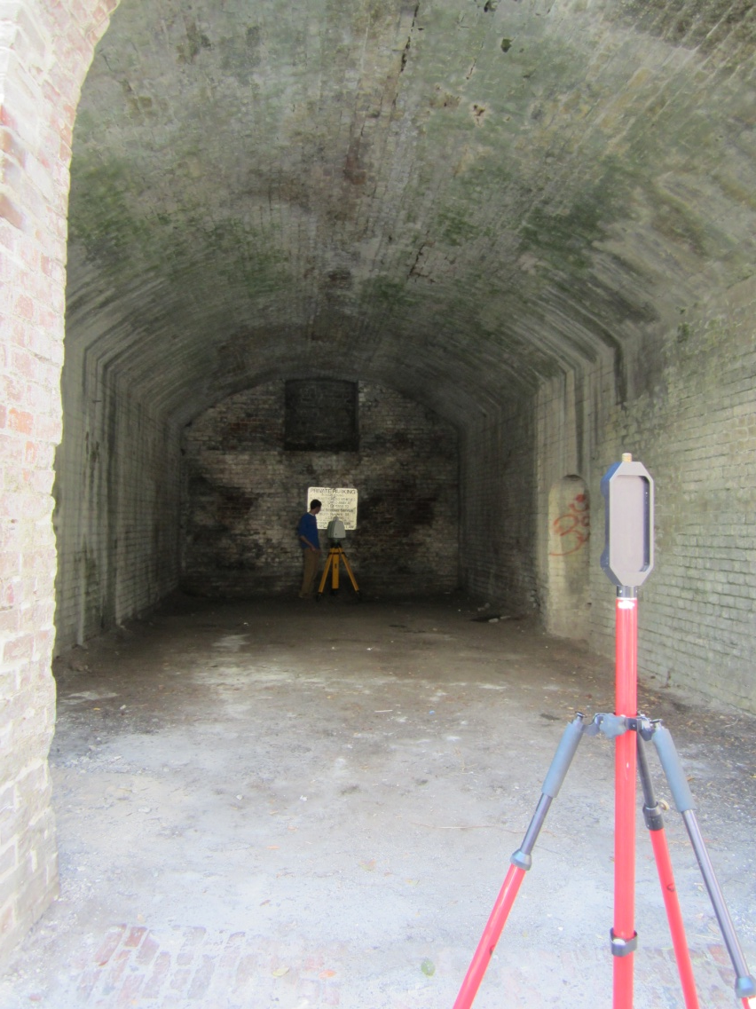
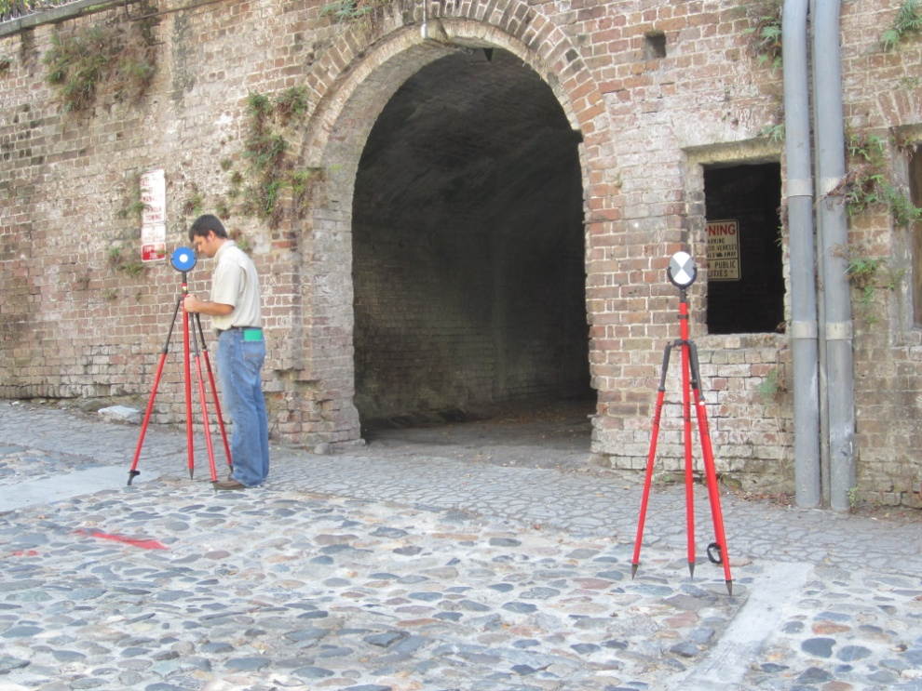
LiDAR 11/4/2012

Slide 10
LiDAR
https://www.facebook.com/photo.php?v=10151313331625953&set=p.10151313331625953&type=2&theater

Slide 11
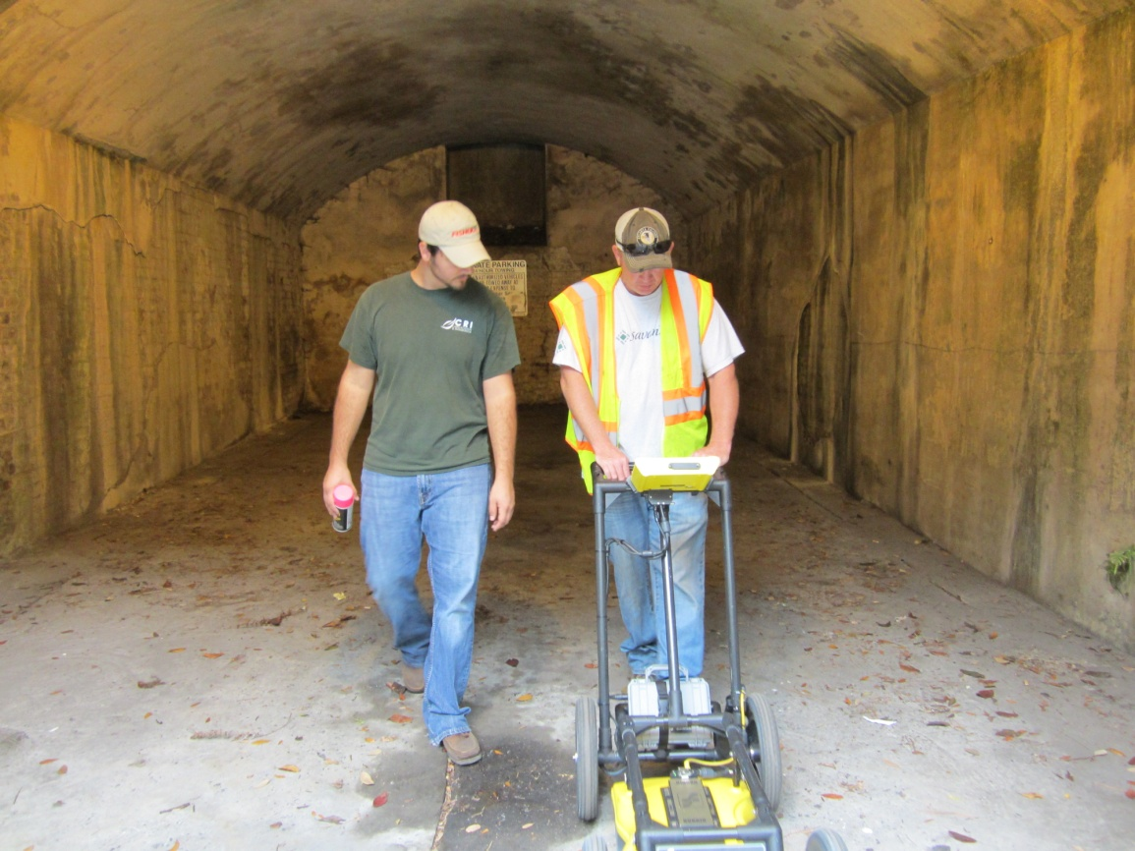
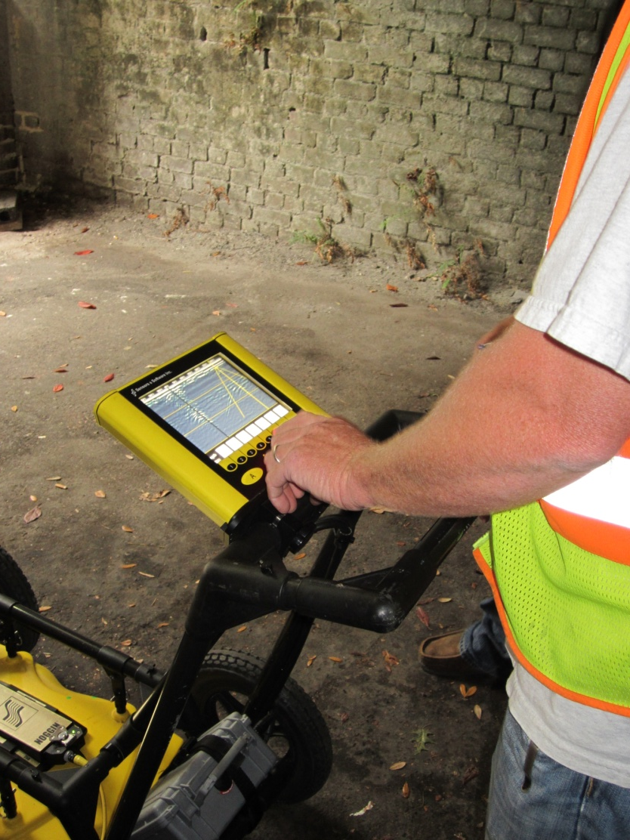
Ground Penetrating Radar (GPR) 11/13/2012

Slide 12
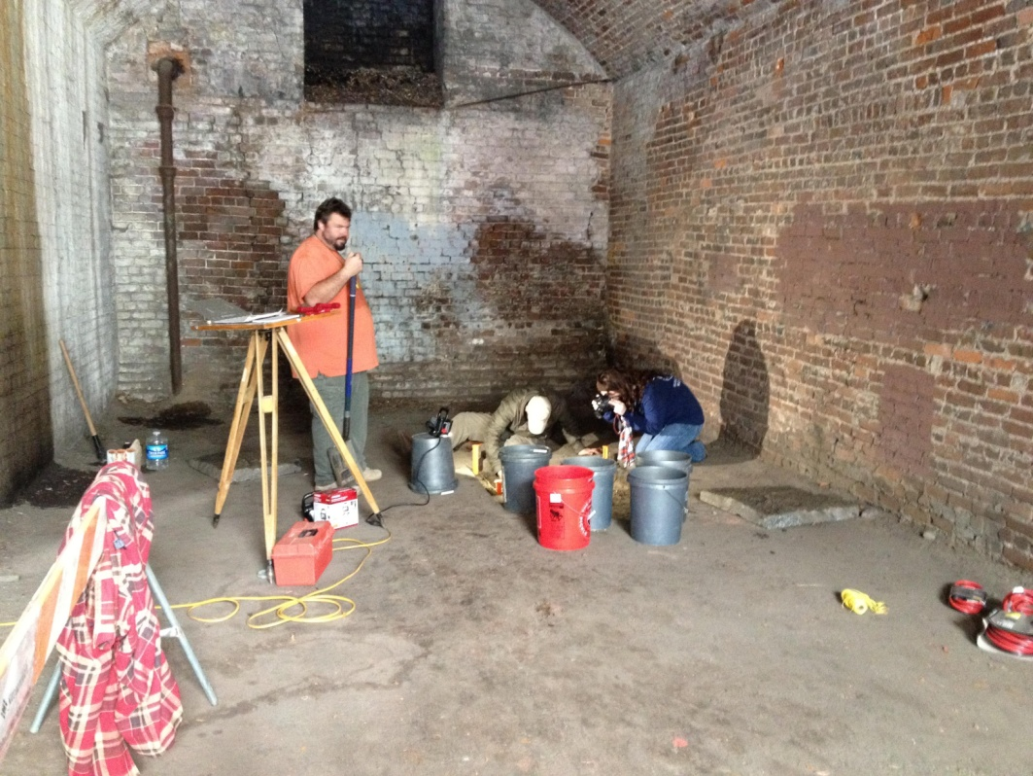
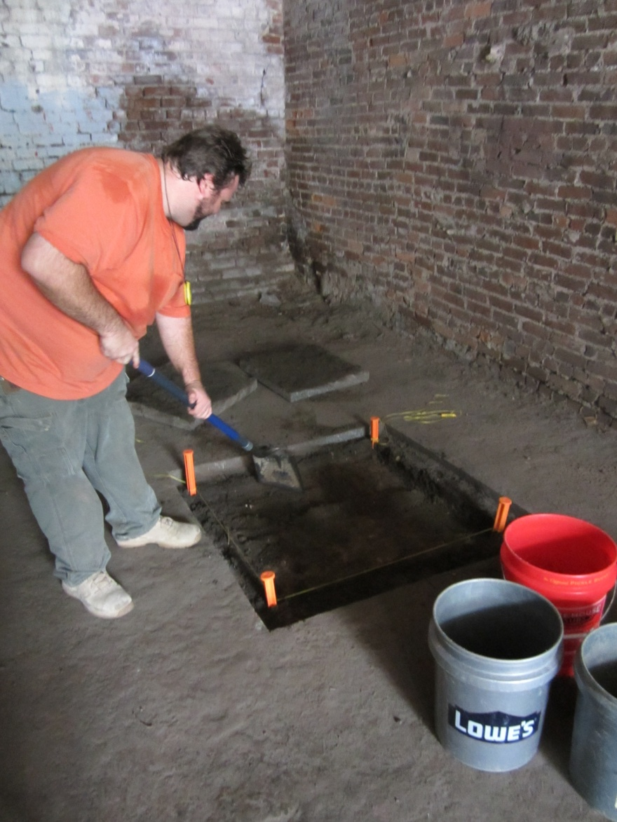
First Day of Excavation (Vault 1) 11/30/2012

Slide 13
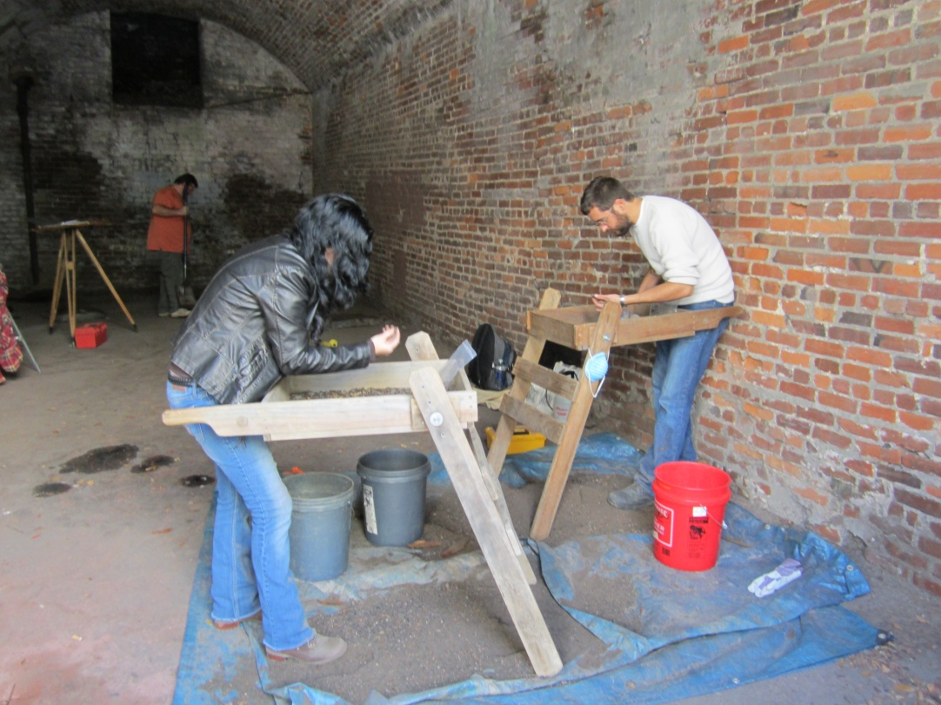
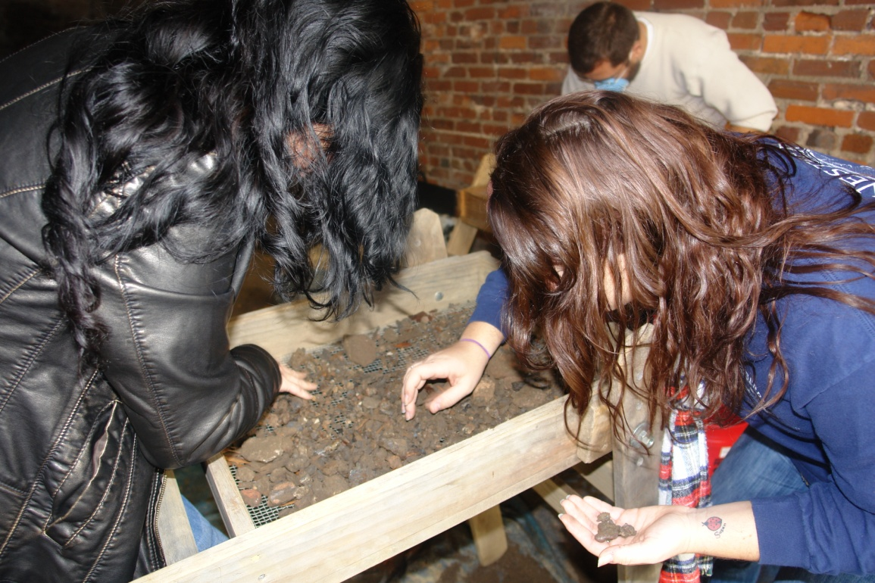
First Day of Excavation (Vault 1) 11/30/2012

Slide 14
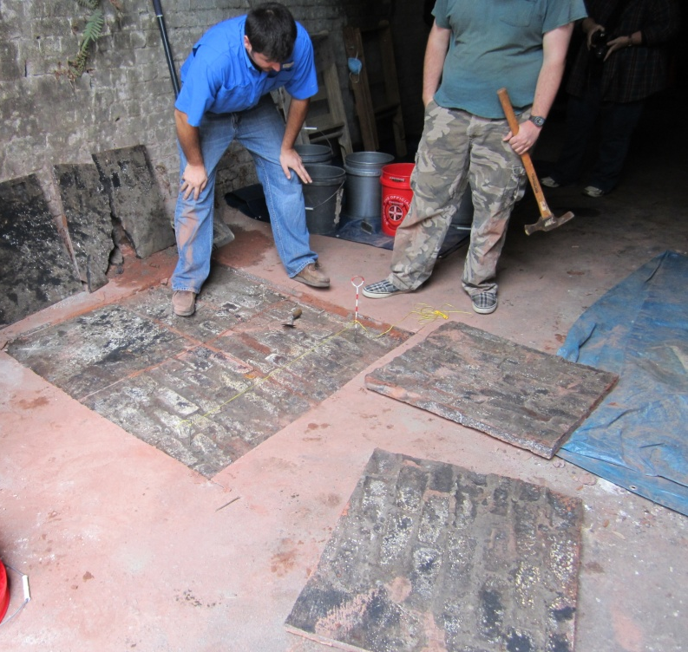
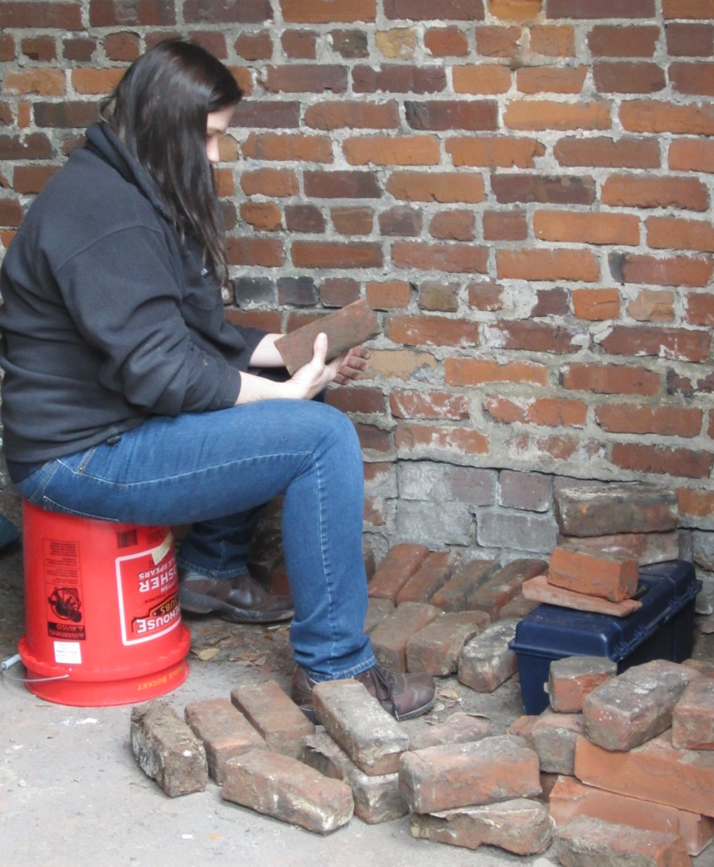
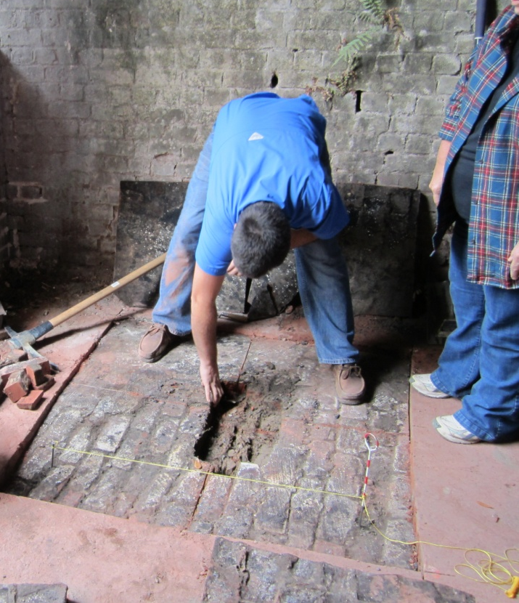
First Public Work Day (Vault 1) 12/15/2012

Slide 15
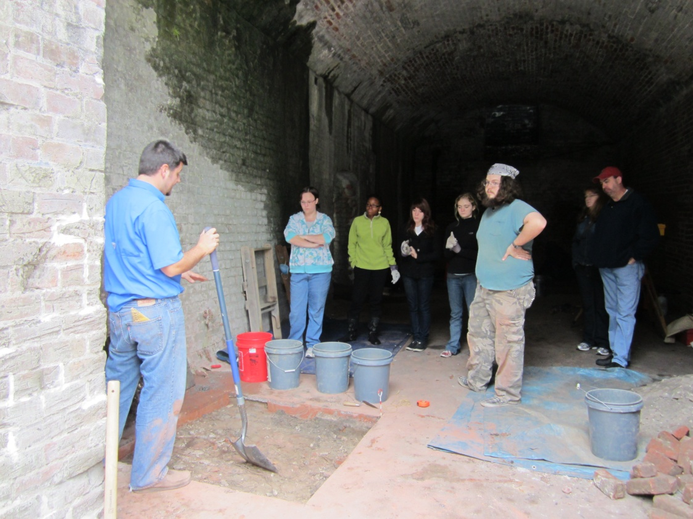
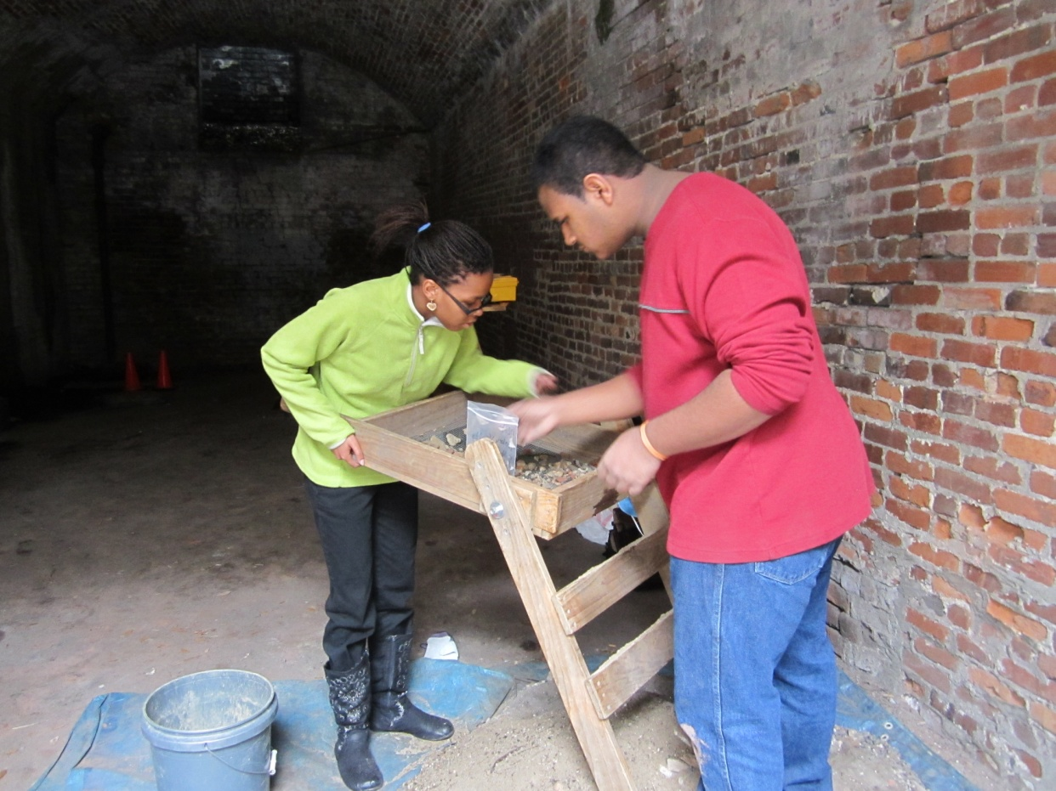
First Public Work Day (Vault 1) 12/15/2012

Slide 16
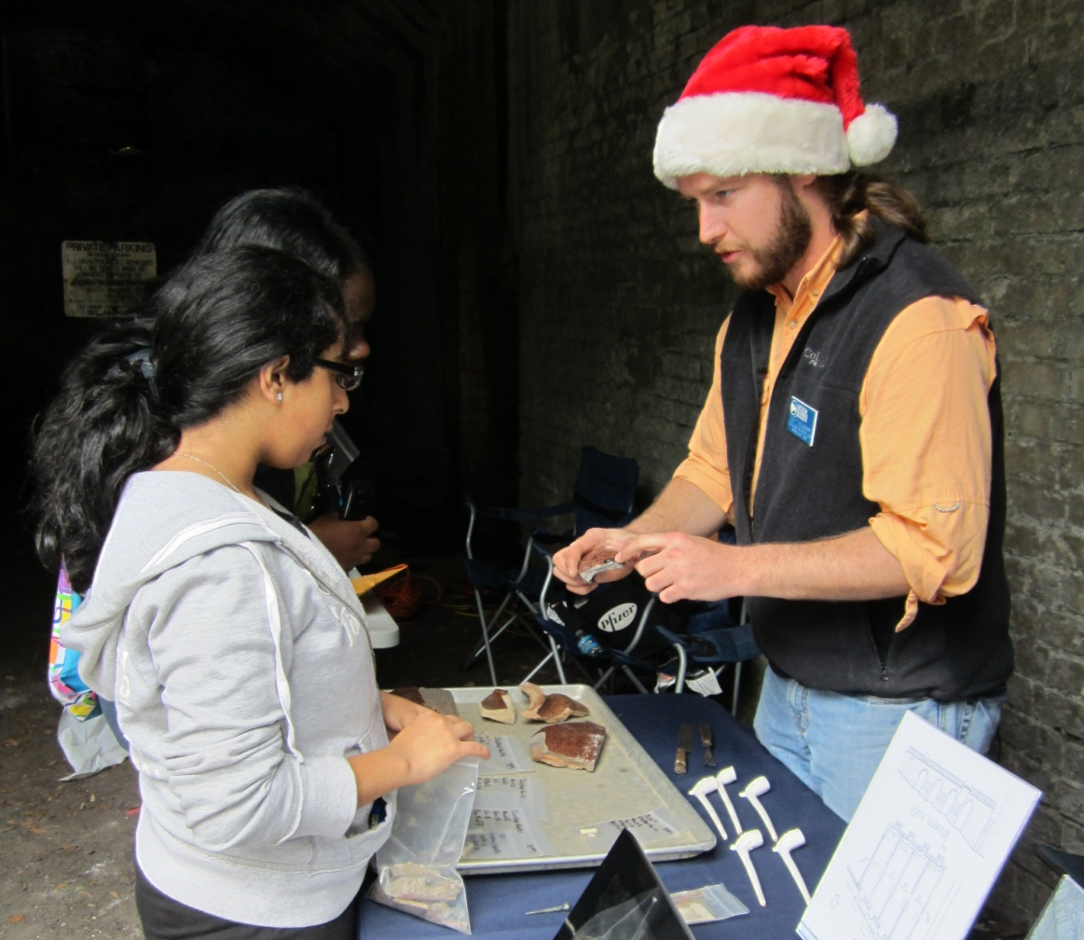
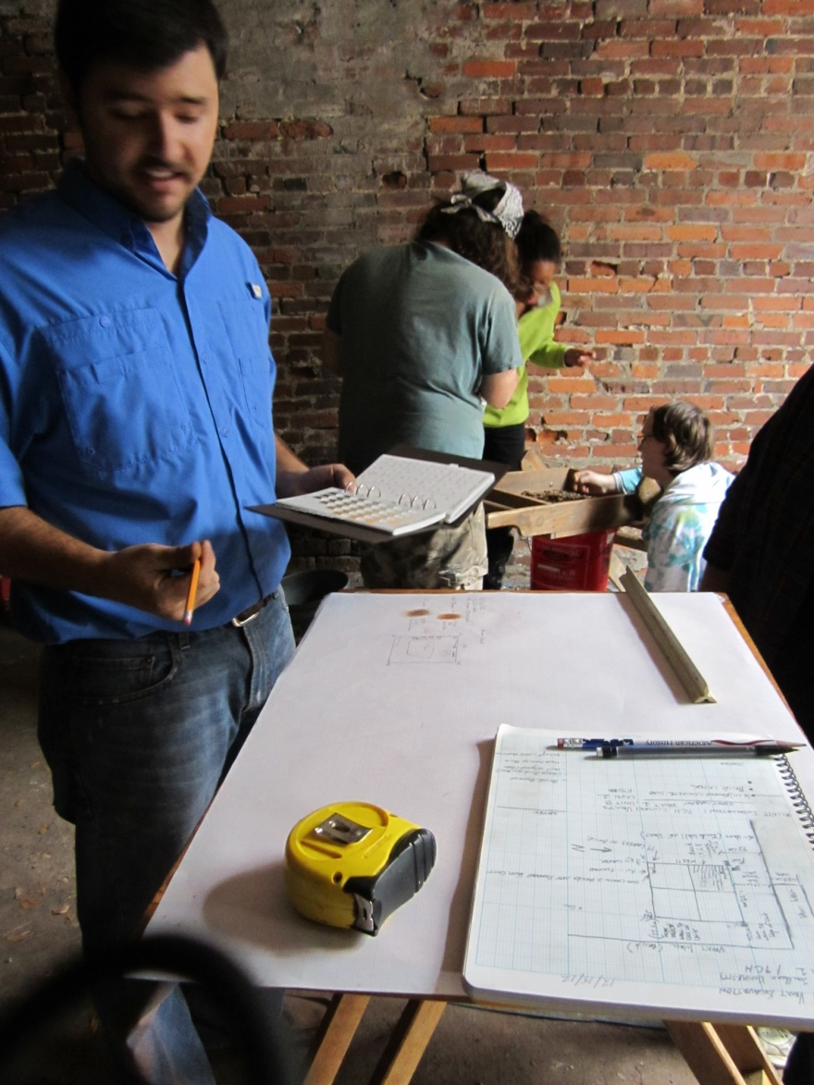
First Public Work Day (Vault 1) 12/15/2012

Slide 17
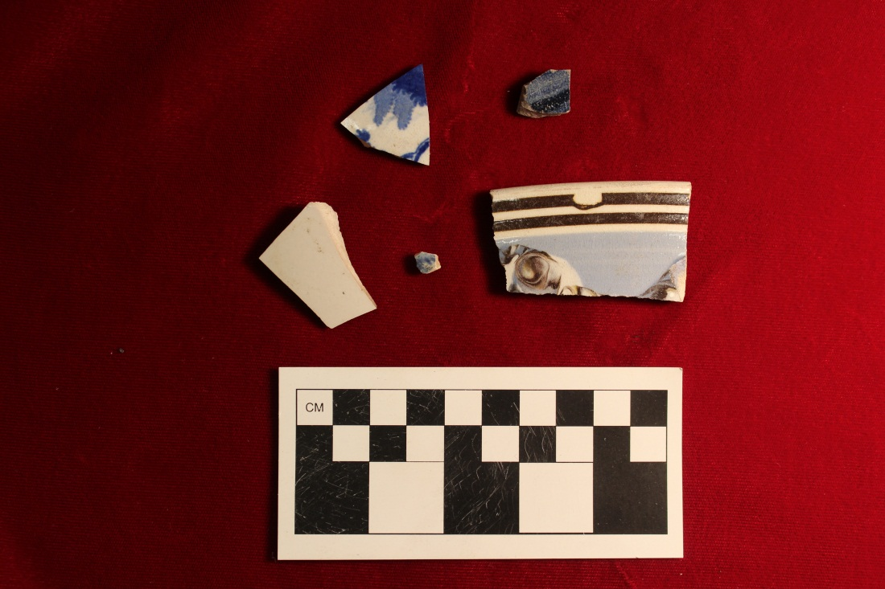
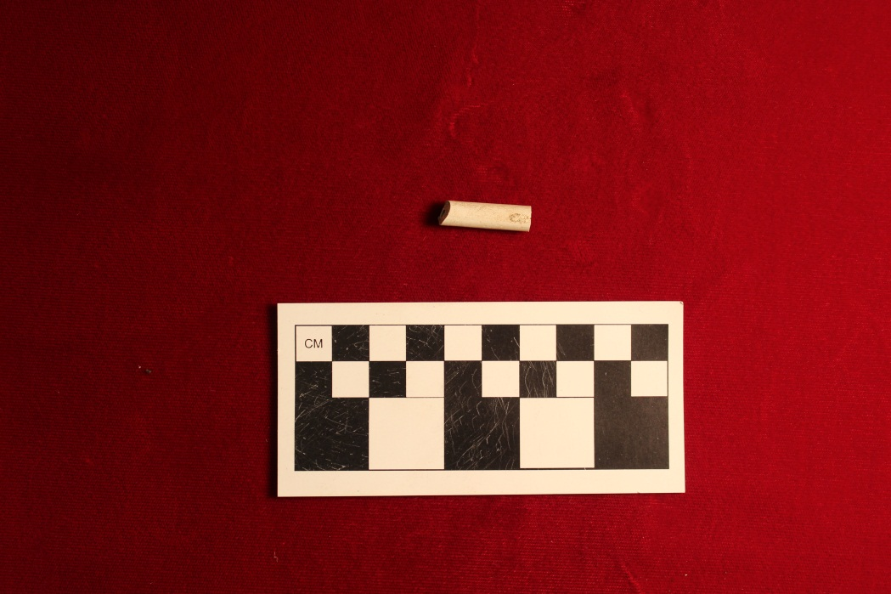
Artifacts - Ceramics & Pipestem

Slide 18
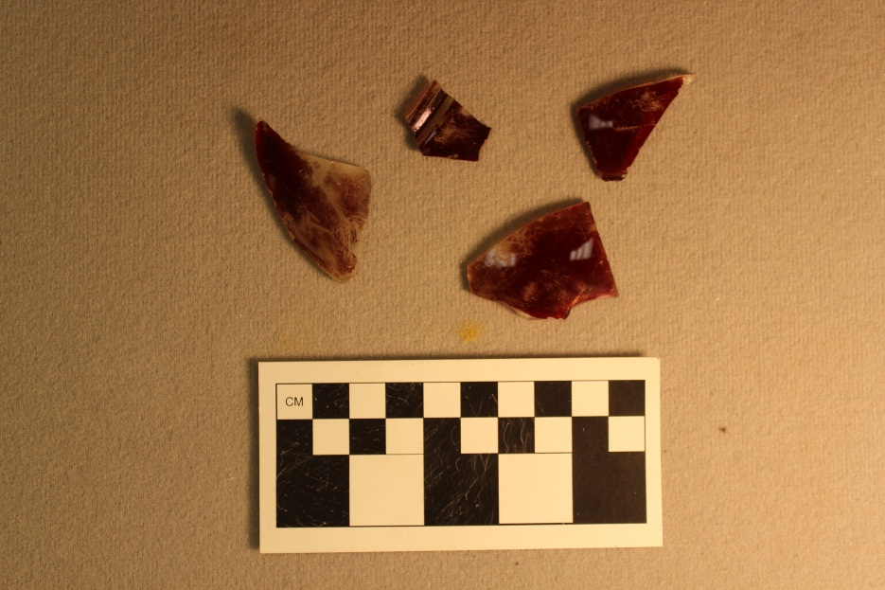
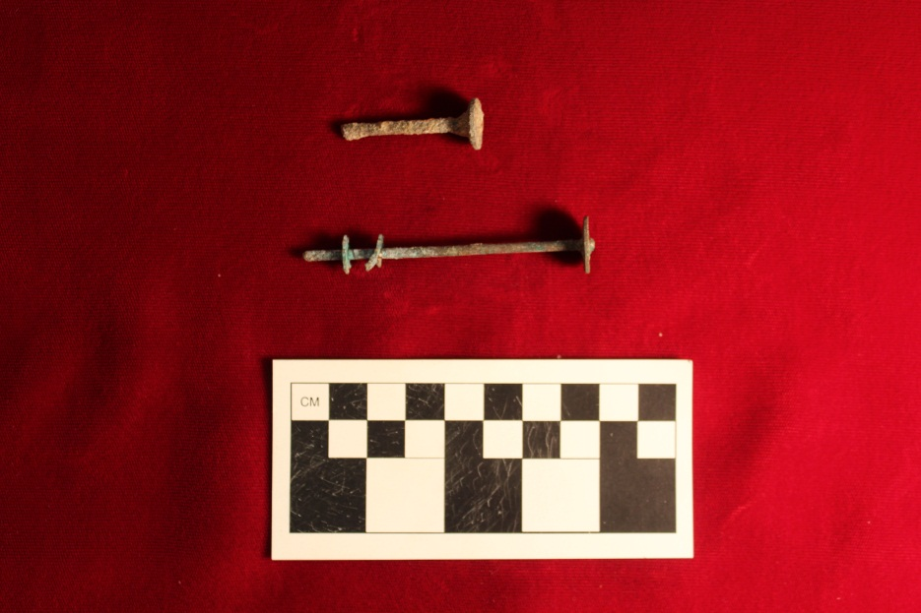
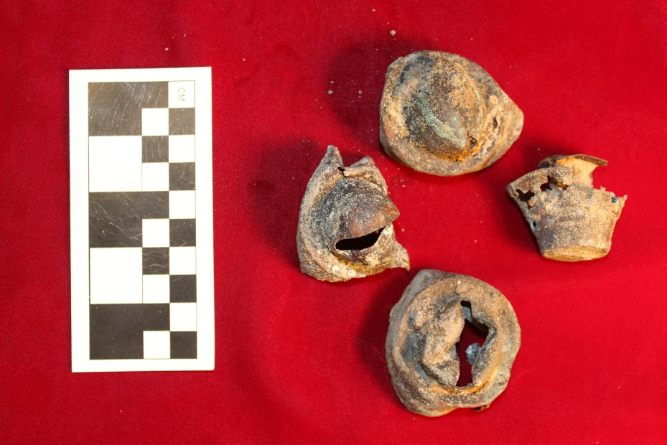
Artifacts - Lamps

Slide 19
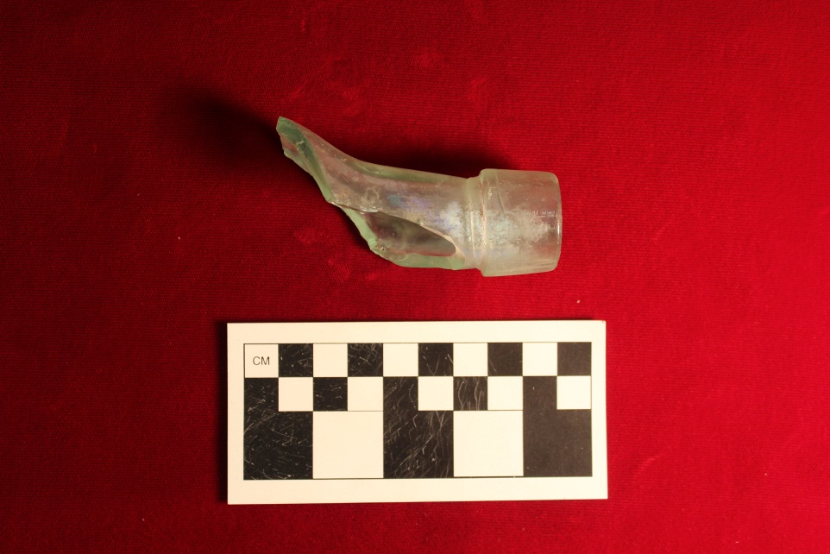
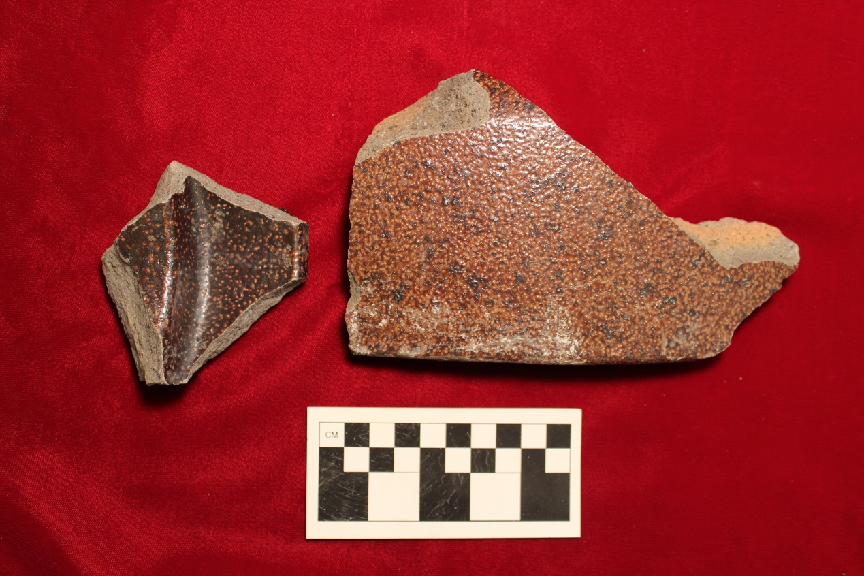
Artifacts - Bottle and Stoneware Piping

Slide 20
Next Steps
Excavations resume 1/18/2013 with GSU Field School
Public Work Day 1/26/2013 10:00 am – 3:00 pm (open unit in second vault)
Two additional Public Work Days
Investigate Fifth Vault
SSU Research Project
Structural Repairs

Slide 21
Goals/End Results
Add to body of knowledge
Educate the public about the importance of the structure (on multiple levels)
More appropriate use and interpretation of the vaults
Educate the public about archaeology
Archaeology and research collection at Municipal Archives for the public
Continued Public Outreach through programs and exhibits

