Slide 1


Voluntary Benefit Offerings
*New Hires*

Slide 2
Voluntary Benefits for NEW HIRES are
GUARANTEED ISSUE
*No health questions will be asked*

Slide 3

Lincoln
Short Term Disability
Guaranteed Issue product, NO HEALTH QUESTIONS
Benefits available up to 60% of your monthly income
You pick and choose the amount of monthly coverage you need.
The rates for this product are based on age, as well as annual income

Slide 4
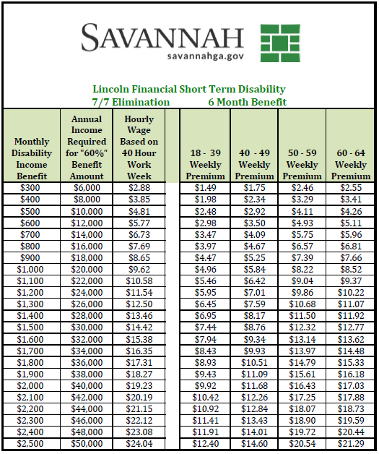
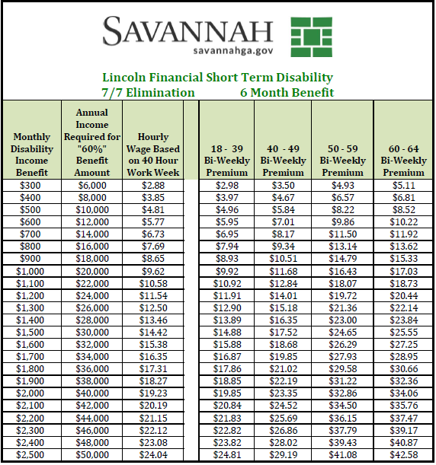
Lincoln Short Term Disability Rates

Slide 5
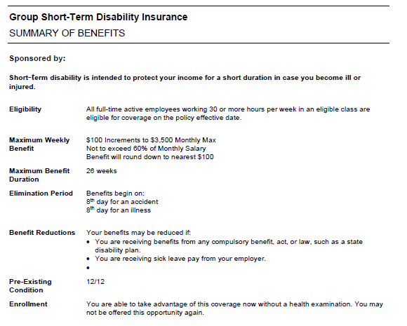
Lincoln Short Term Disability

Slide 6
Transamerica Cancer
WEEKLY RATES | LOW PLAN | HIGH PLAN
Individual | $ 4.75 | $ 7.04
Single Parent Family | $ 5.47 | $ 7.98
Family | $ 8.70 | $12.60
Guaranteed Issue product,
NO HEALTH QUESTIONS (NEW HIRES ONLY)
Generous benefits for:
Radiation, Chemotherapy, and Blood/Plasma
First Occurrence Benefit pays out immediately upon diagnosis
Covers transportation, lodging, and miscellaneous expenses
Wellness Benefit of $100 per calendar year
Experimental Treatment benefit
Coverage for you, you and children, or the entire family
BI-WEEKLY RATES | LOW PLAN | HIGH PLAN
Individual | $ 9.51 | $14.08
Single Parent Family | $10.95 | $15.96
Family | $17.41 | $25.20

Slide 7
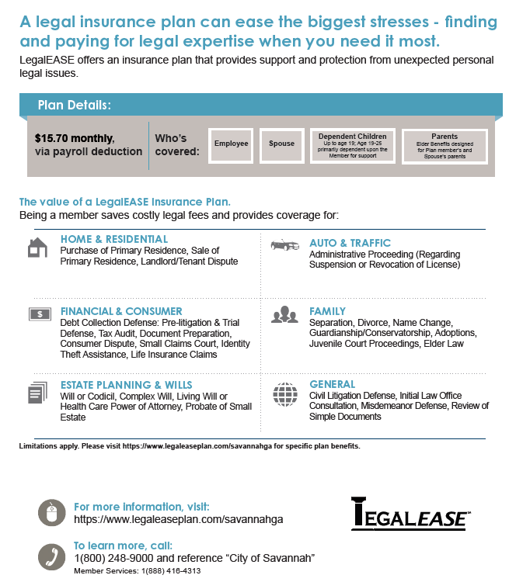


Slide 8

Hartford Accident
ACCIDENT | Weekly Rates
Employee | $ 1.61
Employee + Spouse | $ 2.53
Single Parent | $ 2.69
Family | $4.23
Guaranteed Issue – NO HEALTH QUESTIONS
24 hour coverage--Covers on and off the job accidents
Benefits are paid directly to insured to help with the costs associated with emergency treatment of accidents
Provides protection for you, your spouse, and/or children
ACCIDENT | Bi-Weekly Rates
Employee | $ 3.22
Employee + Spouse | $ 5.06
Single Parent | $ 5.38
Family | $ 8.46

Slide 9
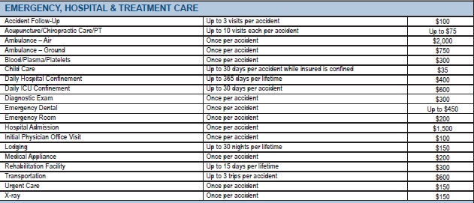
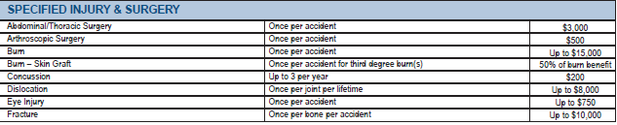
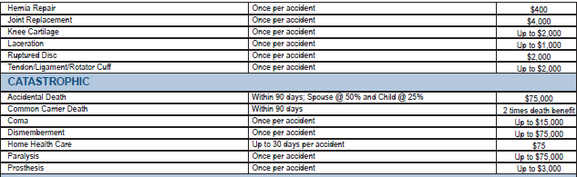
Hartford Accident Benefit Schedule

Slide 10
Hartford Critical Illness
Guaranteed Issue – NO HEALTH QUESTIONS
Covers stroke, heart attack, major organ transplant, advanced Alzheimer’s, paralysis, severe burns, coma, cancer in-situ, skin cancer and others
Lump-sum payment benefits
$10,000, $20,000 or $30,000 coverage available
Wellness Benefit of $50 per calendar year
Provides protection for you, your spouse, and/or children

Slide 11
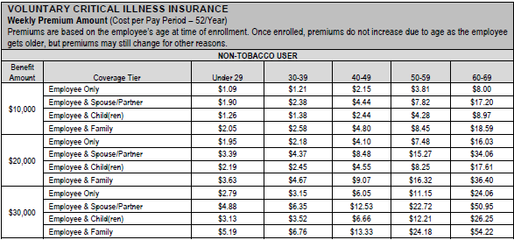
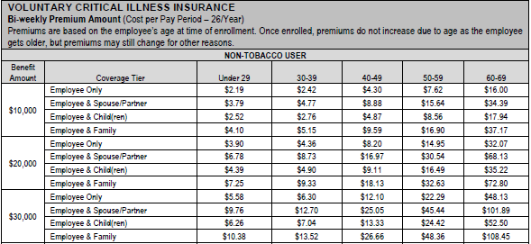
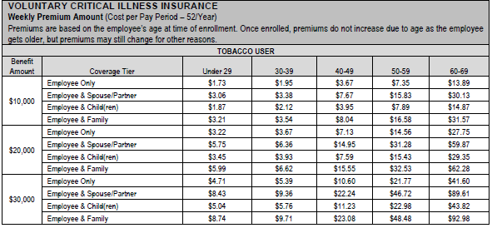
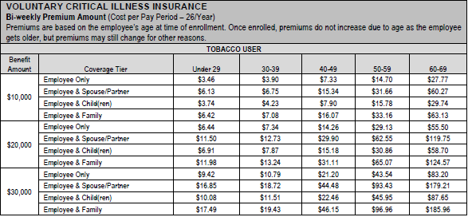
The Hartford Critical Illness Rates
Weekly Rates
Bi-Weekly Rates

Slide 12
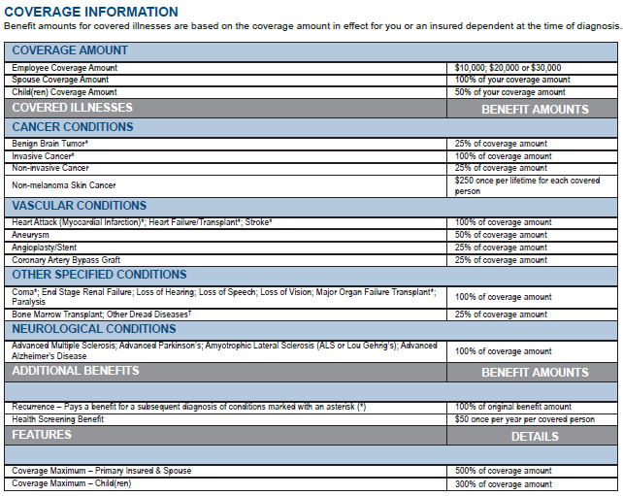
Hartford Critical Illness Benefit Schedule

Slide 13

How to File
a Claim including
Wellness Claims

Slide 14

Please contact
Creative Worksite Solutions
to enroll
or for any questions regarding new or existing plans as well as claims
866.971.9715

